Slide 1
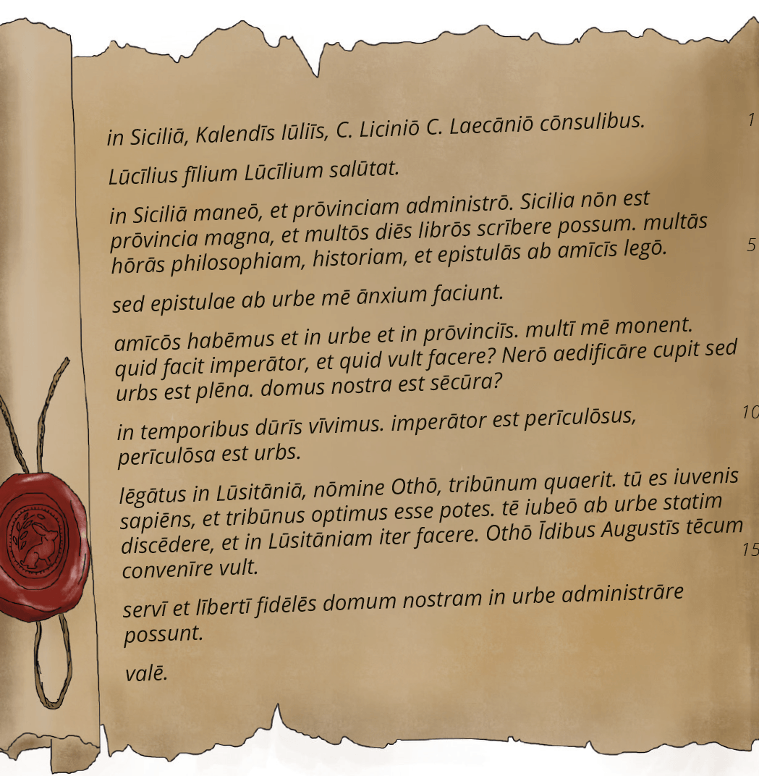
Varying our approaches to stories in a reading course

Slide 2
Four targets of a story
Good story
Language development
Roman civilisation
Literature

Slide 3
Aims: a story
A short story in its own right
Develop/progress the overall storyline
or entirely separate?
Engage, challenge, excite, motivate, calm, surprise
Set in authentic cultural and historical context – why?
Develop characters

Slide 4
Aims: language
Introduce or consolidate a new element of language
Review earlier language topics
Each successive story has another ball to juggle
Limit the word count (150-200 words)
Limit the use of new vocabulary
Include core or target vocabulary
Embed and challenge patterns of word order

Slide 5
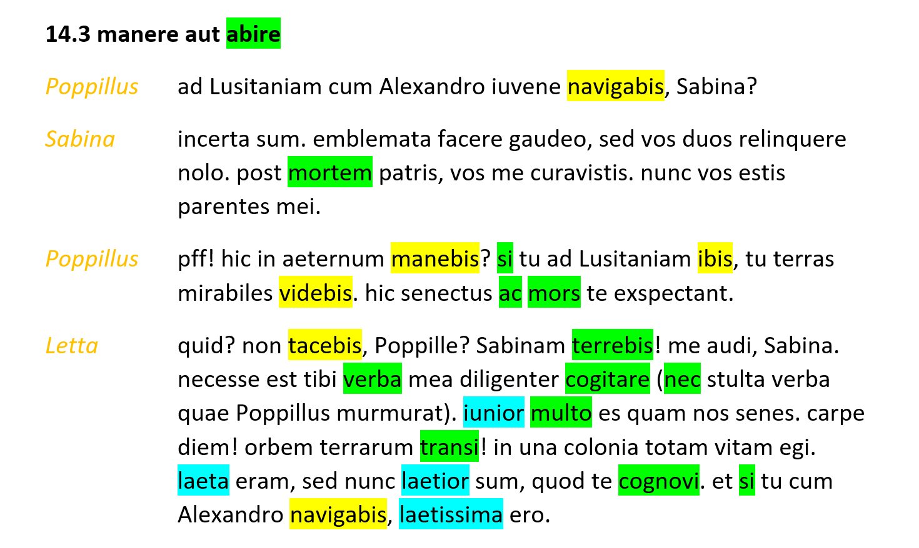

Slide 6
Aims: Roman civilisation
Reflect an authentic cultural and historical context
Raise unheard voices
Introduce or consolidate new cultural topic
Operate as a source for culture
Research, research, research
How would you interrogate the story if it were an original Roman text?

Slide 7
Aims: literature
Variation of tone and pace
Variation of sentence length and structure
Word order
Style (e.g. tricolon, asyndeton, assonance & alliteration)
Creation of mood and image (time, weather, smell, colour)
Preparing students to read Latin literature – what do you look for there?

Slide 8
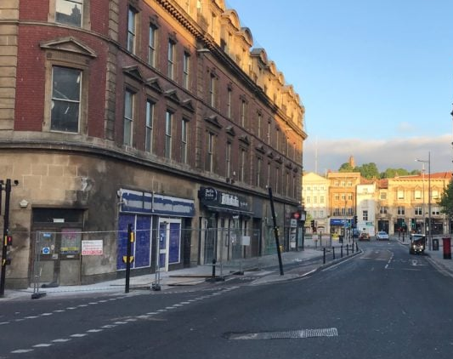
Twenty-two techniques to teach terrific tales

Slide 9
Don’t
Does the story include new or nearly new linguistic elements?
Storyline, characters, culture
If not, you can probably skip it.

Slide 10
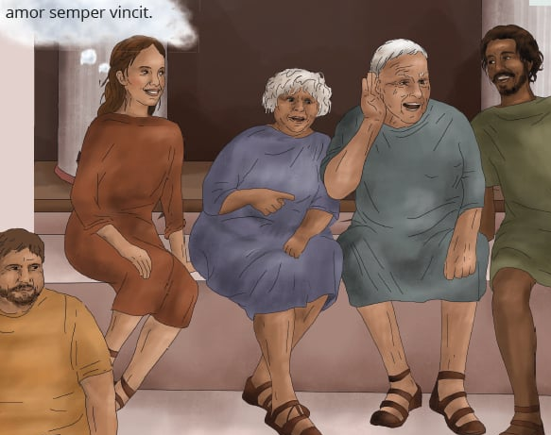
Listen
With or without the text (or first without, then with)
Intonation helps students get gist of story
Grouping of words orally, and pauses, help students group the words in the text
Diversity of empire

Slide 11

Pre-read for vocabulary
Scan the text
Which words do we know?
Which words can we take a reasonable guess at?
Which words will we need help with?
Choose your target vocabulary in advance

Slide 12

Pre-read for sense
Scan the story
Can we get a general idea of the story without reading in detail?
Use the title
Use the glossed words
Before closer reading, students summarise what they think happens in (e.g.) 30 words
How close was your prediction?

Slide 13
Accelerated reading
Read a story in 5 mins
Students follow Latin while you translate
Gaps to check the students are following
Choose gaps to focus on particular elements of culture, language or literature
Similar to not reading the story at all, but ensures students know the storyline. Also have contact with vocabulary and grammatical features
Can apply to whole story, or just part

Slide 14
Cut it up and reassemble
Type up
Type up, starting new sentences/sections on new lines, so it’s not just a jigsaw
Cut out
Cut out sentences/sections and jumble up
Understand
Students need to understand at least the gist of section to work out where it goes in the story
Letter or number
Letter or number each section (not in order!), to make review easier
Differentiate by
Differentiate by granulation of sections: more sections = more challenging

Slide 15
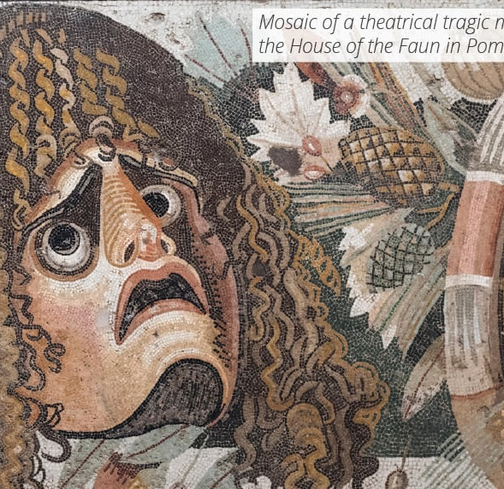
Act it out
Great for small group work
English or Latin (or bit of both)
Add parts
Add text/speech (English or Latin or both)
Judging? X Factor, School’s Got Talent
Imagine the audience doesn’t understand Latin: lots of expression
Students find spaces around school for rehearsing
Film at home

Slide 16
Be a film/movie director
Write film directions for the story (or a scene)
How does the movie start? Wide location shot? Close-up? Landscape setting, or detail of a room?
What music to set the scene?
Who enters/leaves, from what side?
What expressions on the faces of the characters?
Pauses?
How does each character speak? Regional accents? Speed? Volume?
Study a movie script first

Slide 17
Ask the story
Teacher uses oral comprehension questions (in English or in Latin)
Target questions precisely
Differentiate for students’ strengths/weaknesses – challenge, but enable success
Determine focus/foci in advance
Can be a quick way to read a story

Slide 18
Written comprehension
Not the intention of reading courses that students read/translate every sentence
Fine to scan for information
Create differentiated versions
Sometimes focus on story, sometimes on culture, sometimes on language, sometimes on literary techniques
Good for homework, supply/sub, or if you need a break
Hands Up creating two PDFs per chapter and auto-mark digital comprehensions for Suburani

Slide 19
Story in images
What are the themes of the story?
What are the key words?
Are there different scenes?
What about the emotions, colours, smells, etc?
Google some images that represent the themes, key words, scenes, emotions, colours, smells etc
Create a montage of the story for wall display or website

Slide 20
Variety of study partner
Create variety by having students read in pairs, but pairing with a student they don’t normally work with (you plan in advance)
Could be a series of lessons where the pairings change
Good preparation for the world of work
Build friendships
Share skill sets

Slide 21
Find 5
Datives, adverbs, adjectives
Instances of interesting word order
Items of vocabulary that create a mood
Pieces of evidence about Roman insulae
Examples of bias
Steps a character took to achieve/avoid something

Slide 22
Spot the 5 misatkes
Create a new version of the story with errors
Tense out of place
Number of nominative and verb not agreeing
Noun/adjective non-agreement
Character says something that doesn’t fit, picks an item up from where it wasn’t, etc.
Cultural context error (can be subtle)
Variation - spot the difference: having read the original story, show them an adapted version and try to slip 5 changes past the students

Slide 23
Individual reading
Give students time to read a story on their own occasionally
Replicates assessment situation
Lets you and the student know their strengths and weaknesses
Some students appreciate the calm
Can be combined with quasi-assessment techniques (e.g. comprehension and translation), though better if not a ‘test’

Slide 24

Cloze exercises
Type up the story (or part of)
Remove some words or phrases and place in a pool below the story
Students work individually or in teams to put the words/phrases back in the right place
Differentiate by:
  not providing the missing words
  providing additional words
  removing endings rather than whole words
Project onto board and do in two teams

Slide 25
Simplified versions
Create differentiated versions of a story
Type up
Colour up nominative and verbs
Colour up nominative, accusative, verb
Colour up relative clauses, adjectives, genitives
Remove various levels of detail – can create increasingly simplified versions
Change vocabulary, or provide various levels of glossing

Slide 26
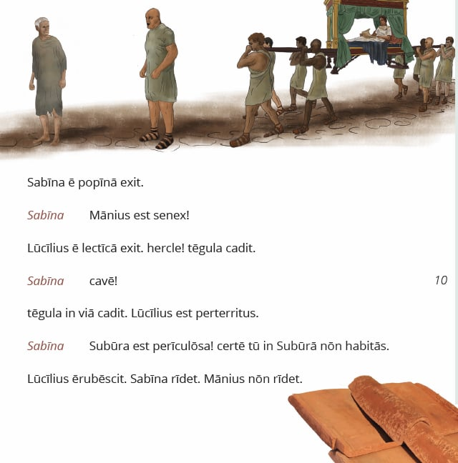
Story as a source
What does the story tell us about Roman culture/civilisation?
If it were the only source we had about the Romans, what could we deduce about them?
If there’s a roof tile, what else must there have been?

Slide 27
How does the author develop the characters?
Study the story for character development
Brain storm feelings about characters before the story
Students provide evidence based on texts
Repeat after reading story
How have feelings changed?
How has author changed our feelings?

Slide 28
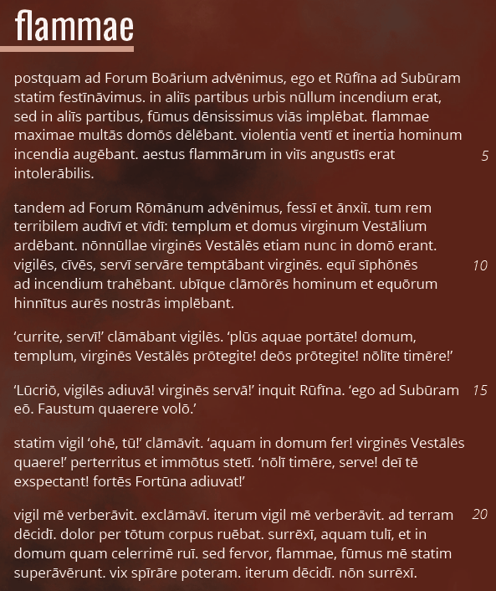
Review for impact of literary techniques

Slide 29


Hot seat a character
Teacher or student takes on role of a character, others ask questions…
  How does it feel to have (been)…?
  How do you feel about …?
  Why did you …?
  What will you do about …?
  Did (other character) tell you something that …? (Remember that not all the action happens/is recorded in the stories – what happened off stage?)
Can also work well for minor characters, or even those who weren’t in the scene (how do you feel about being left out of …?)

Slide 30
Day in the life of/diary entry
Take a character and write about their life outside the story
What else had happened earlier that day?
What happened after the story?
Explore motivations of characters
Does the way they are presented/present themselves in the stories reflect who they really feel they are?

Slide 31
Create a storyboard
Which 6-12 scenes/images stick in the mind?
Students sketch the scenes to make a storyboard
Can add brief captions or speech bubbles
Stick-people etc. fine
Or take one stand-out image and draw that
Which items of vocabulary relate to particular images?

Slide 32
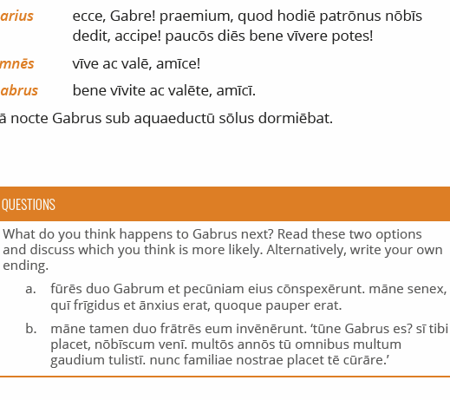
What happens next?
Students continue the story, in Latin or in English
Or adapt to ‘What happened previously?’

Slide 33
Tell your neighbo(u)r
Students work in pairs
Once they’ve read the story
  Student A has 5 minutes to make a bulleted list of events which happened in the story (without telling Student B what they are)
  At the same time, Student B is looking over the story again
At the end of the 5 minutes, Student B tells the story back to Student A.
Student B scores a point for every item on A’s list. Student A scores a point for every item B didn’t find.
Next story, swap roles.

Slide 34
Dictation
Old school!
Go back to a story from ~ 6 chapters earlier
Teacher reads the story (or part of it) out
Students try to write it down as accurately as they can
Practices listening and language skills

Slide 35
Re-read earlier stories
MFL vocab acquisition research (Language Learning Journal, 2012, Special Issue: Vocabulary) has indicated that the two most successful methods of vocabulary acquisition in MFL are (i) reading and re-reading stories and (ii) bi-lingual list learning
Give students time to go back and re-read stories they’ve already read.

Slide 36
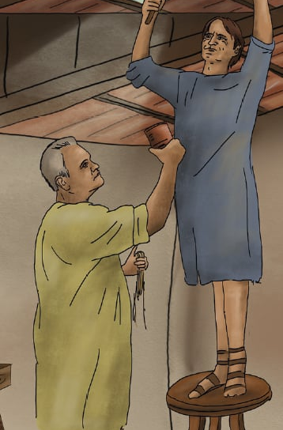
Your task
Make a list of the stories you’re going to teach this year
Apply each one of the techniques above to at least one story, so you try each technique at least once

