Slide 1
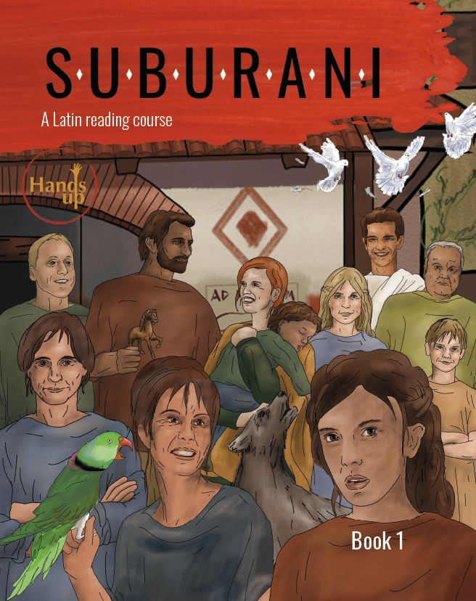
2 textbooks
Latin 1 and 2
GCSE
Print and online editions
Book 1: Chapters 1-16
Book 2: Chapters 16-32
Book 3 … ?

Slide 2

Each chapter:
- 16 pages
- 10 pages language
- 5 pages civilization
- 1 page myth or history

Slide 3

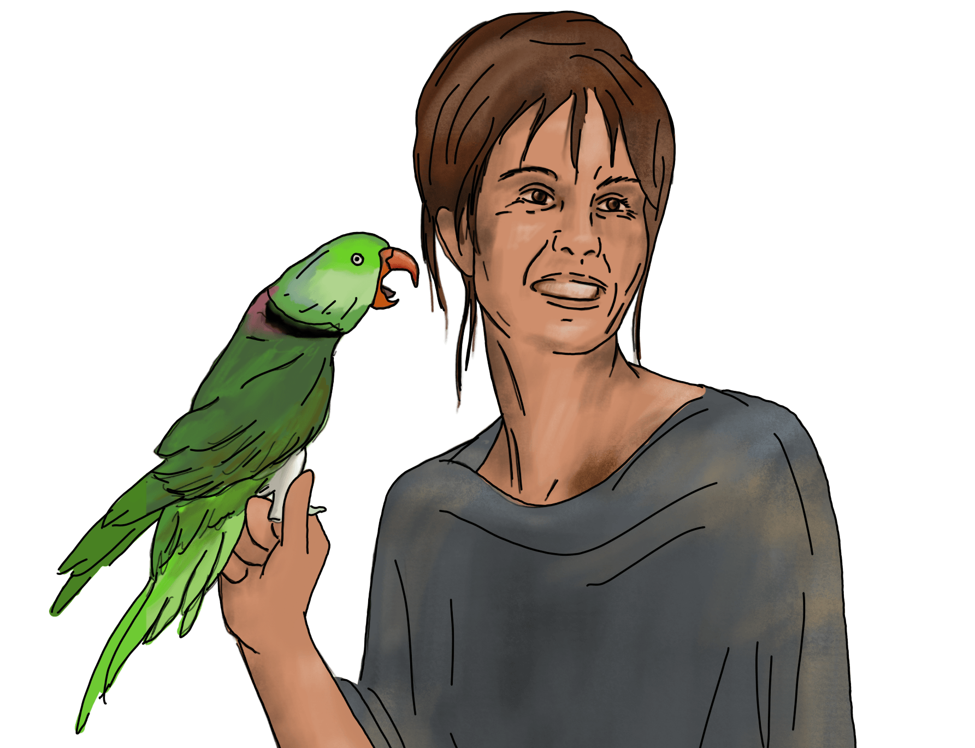
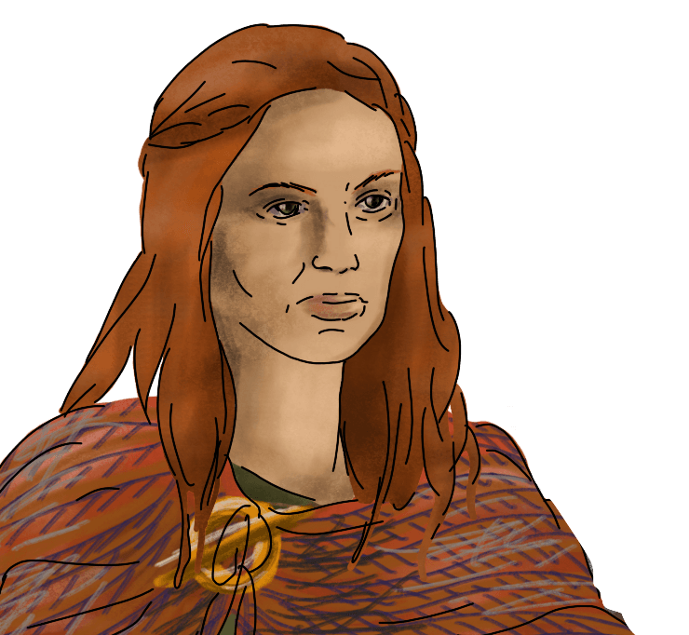
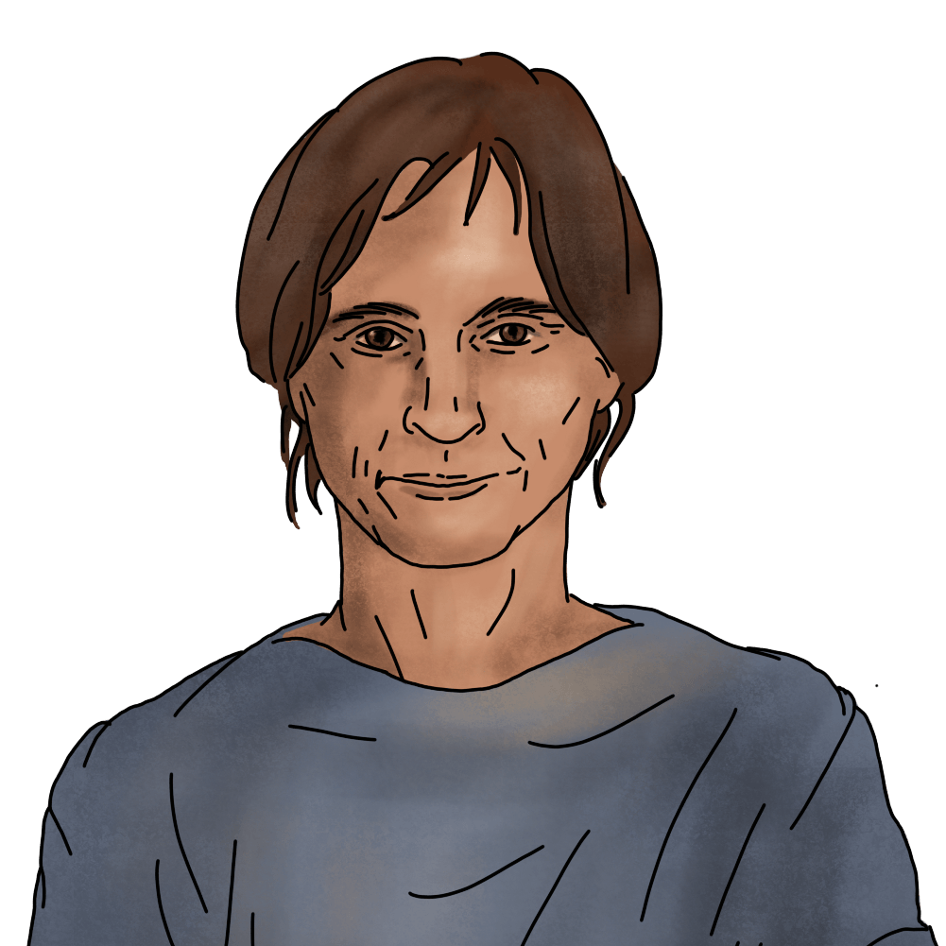
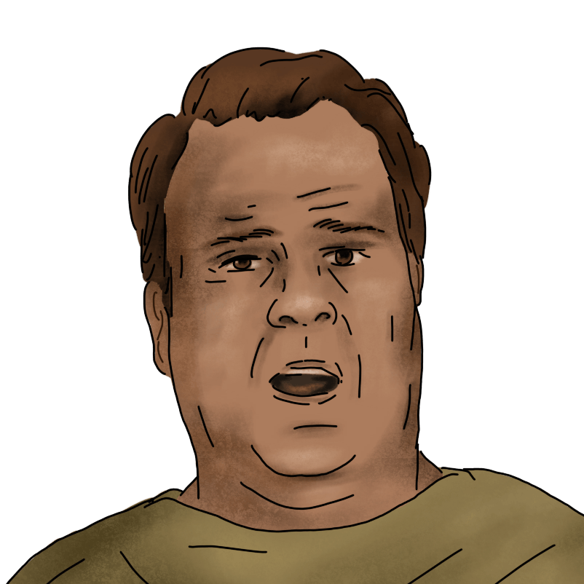
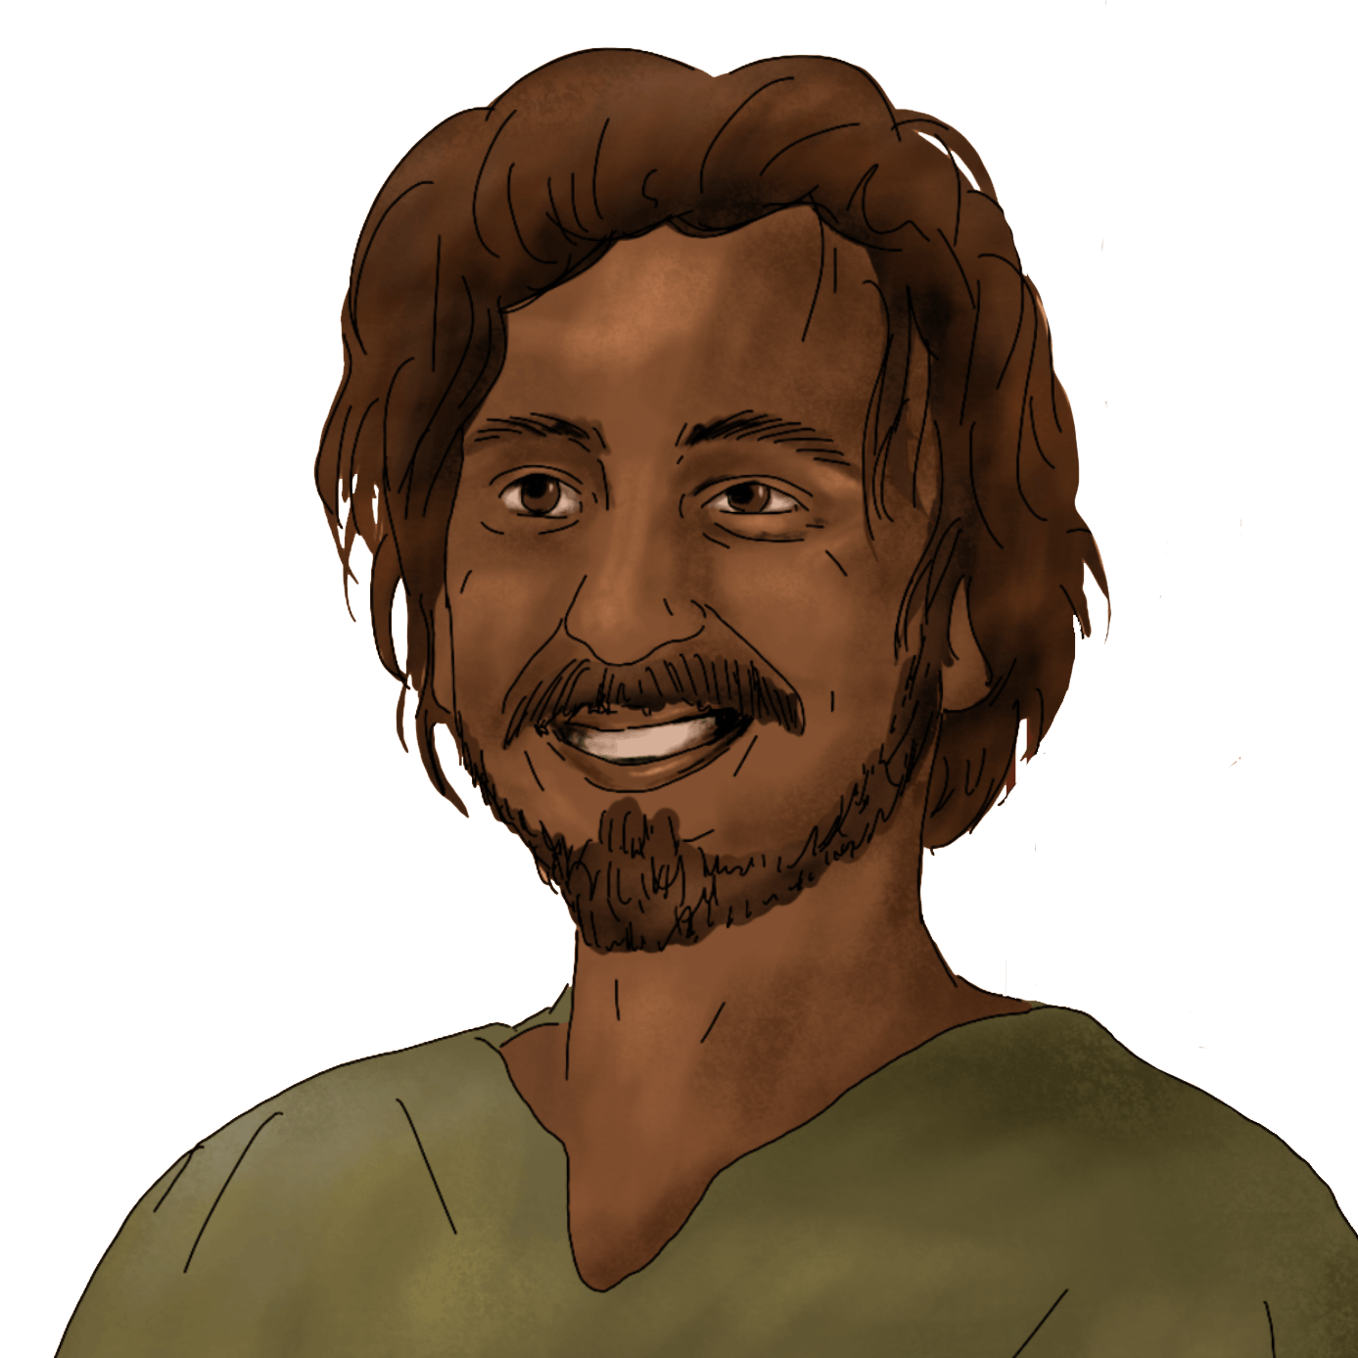
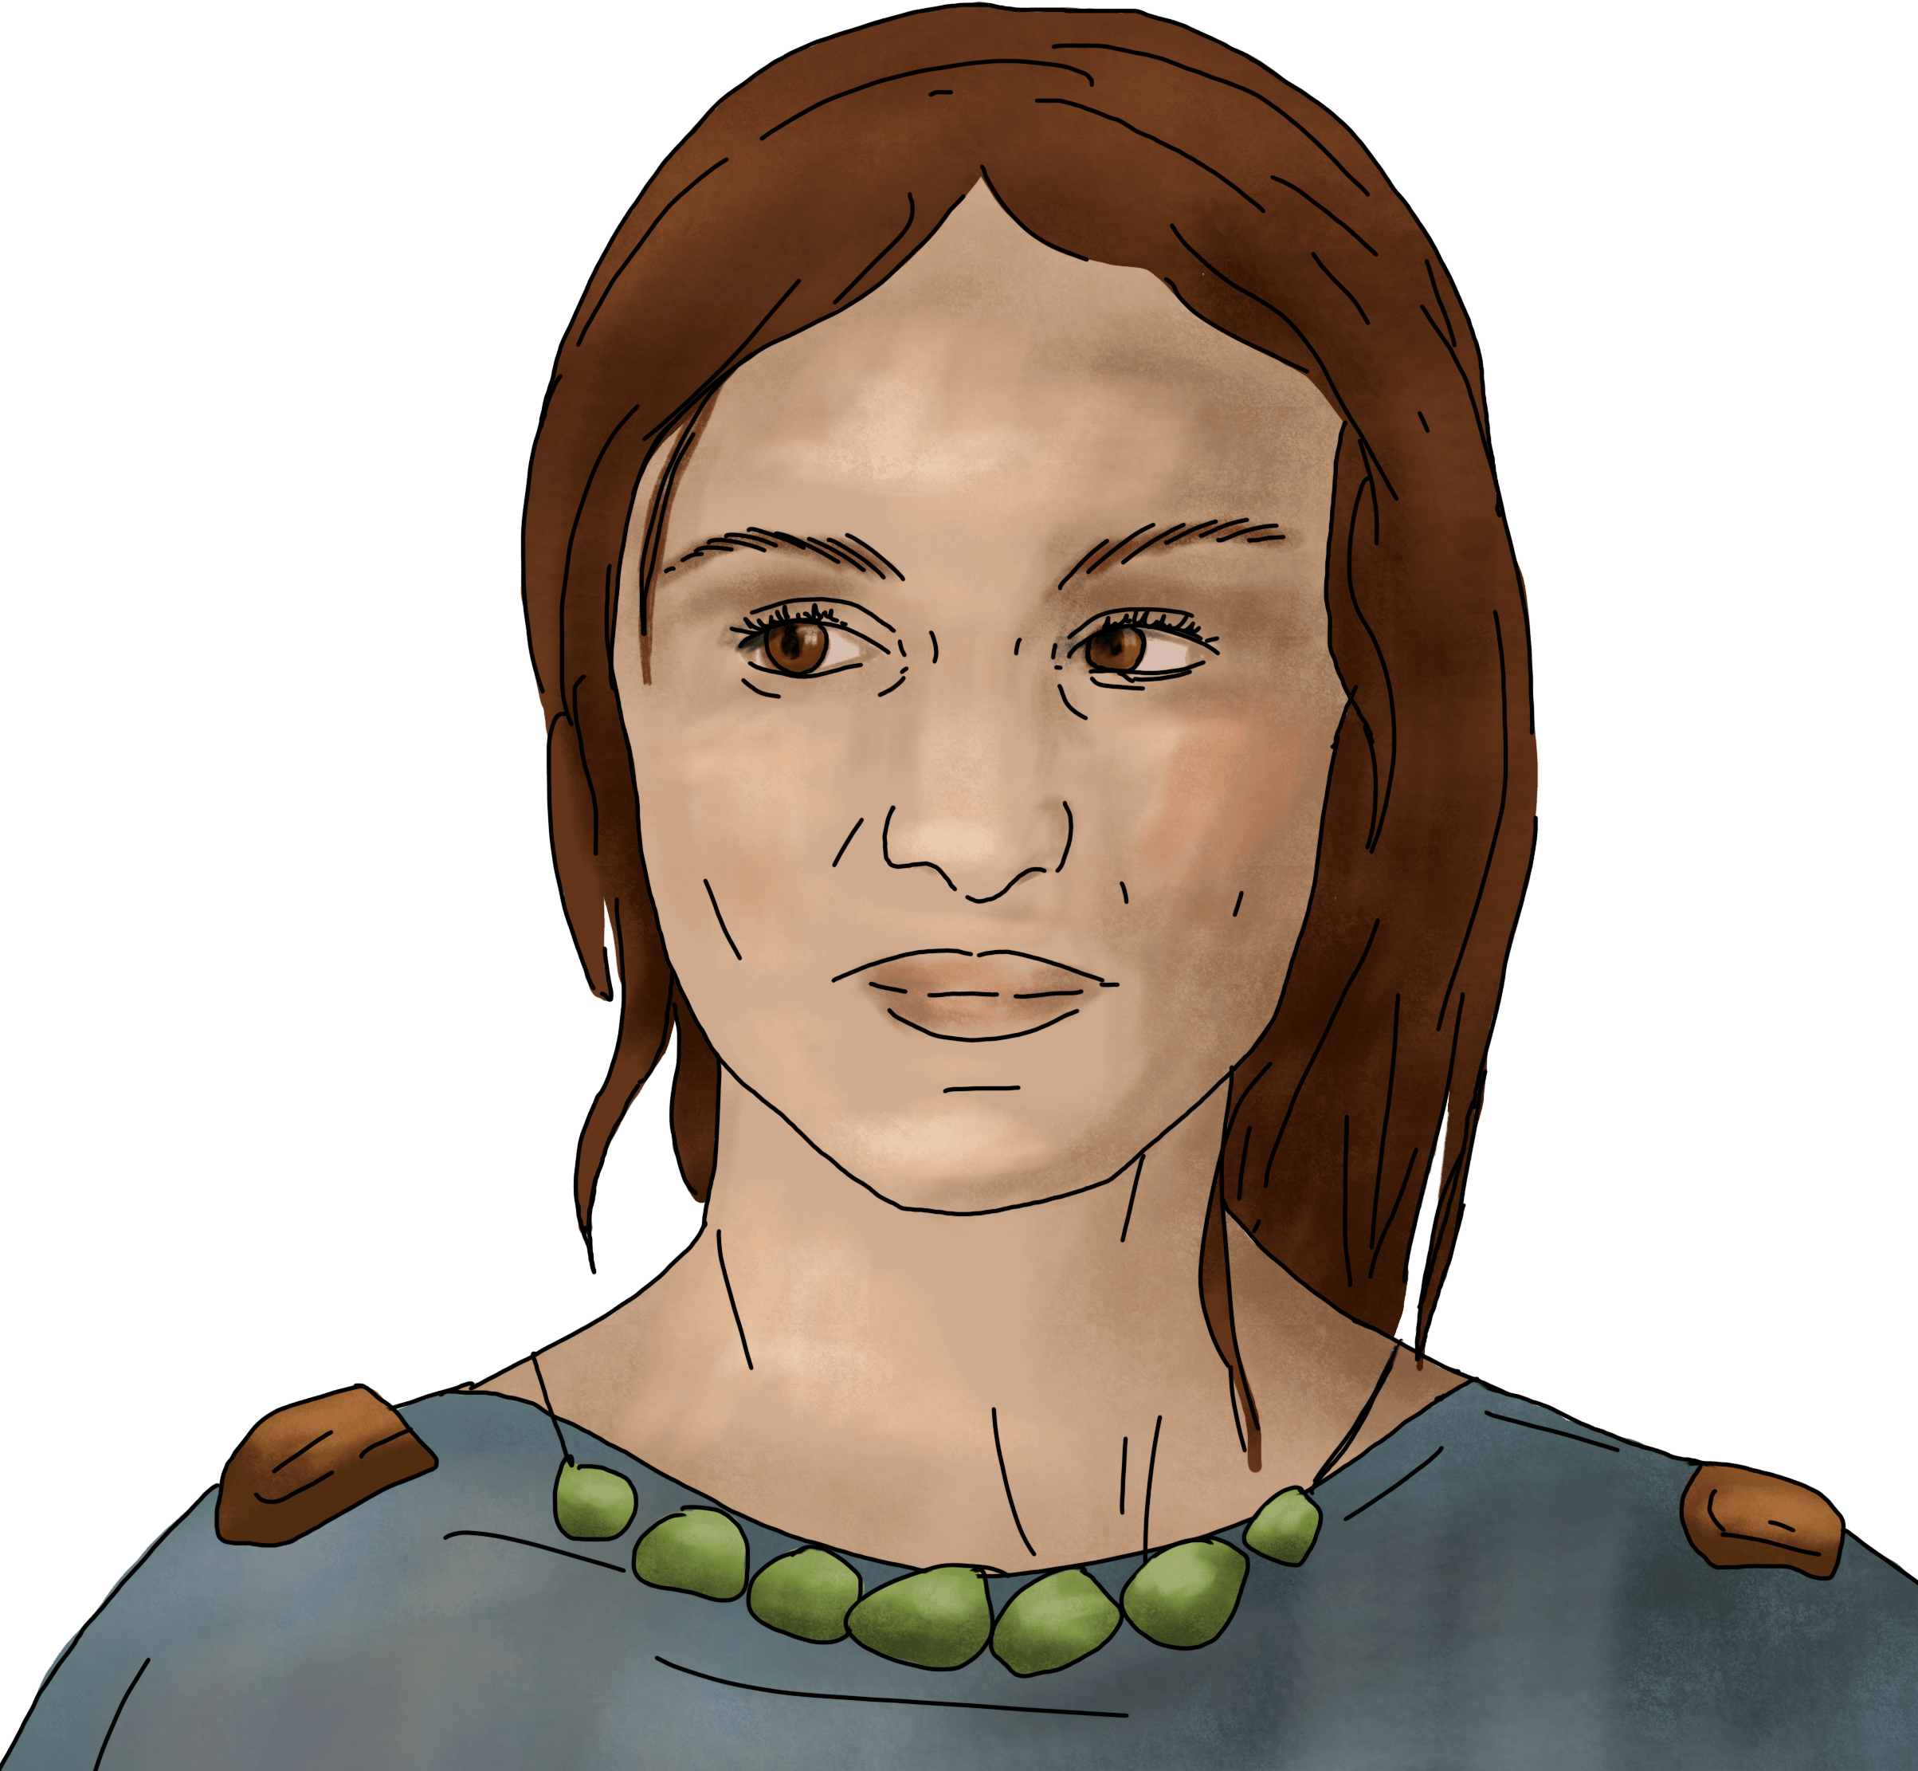
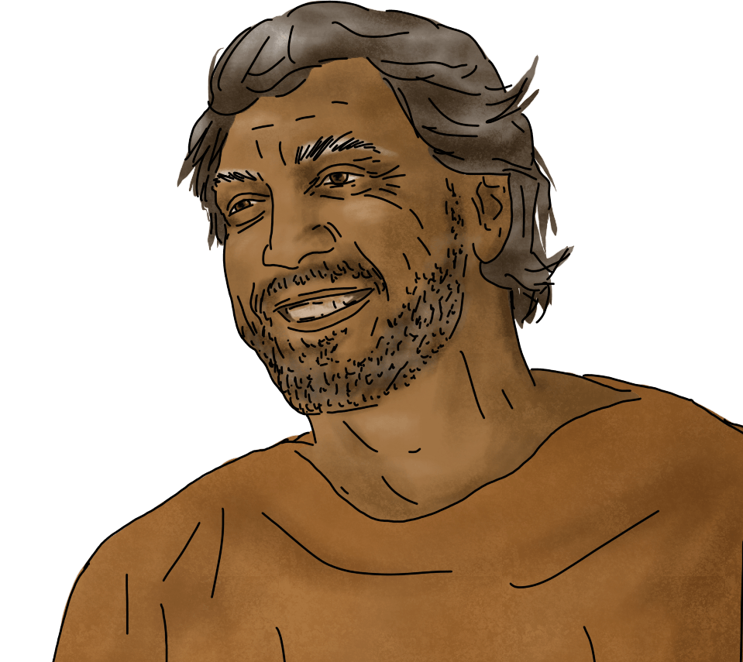
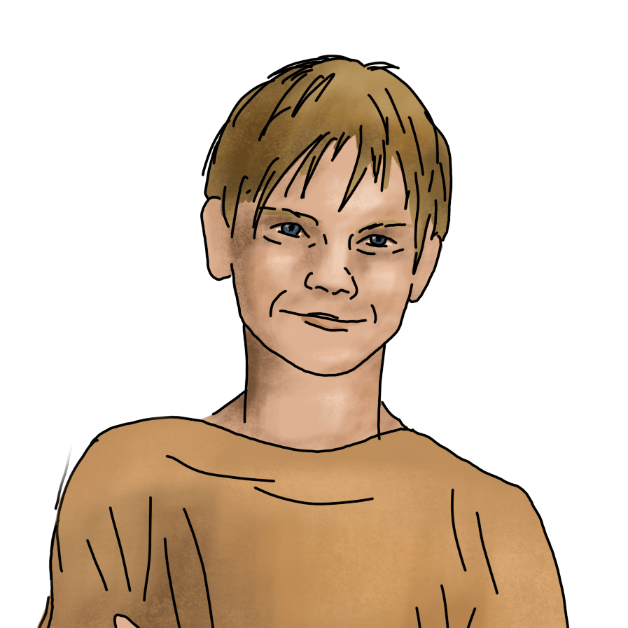

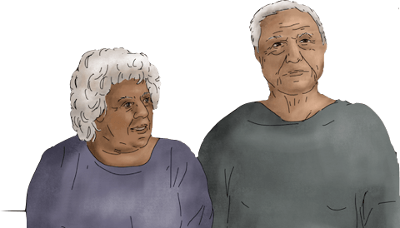
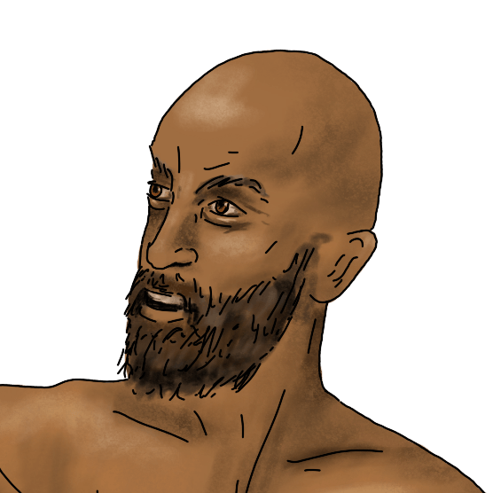
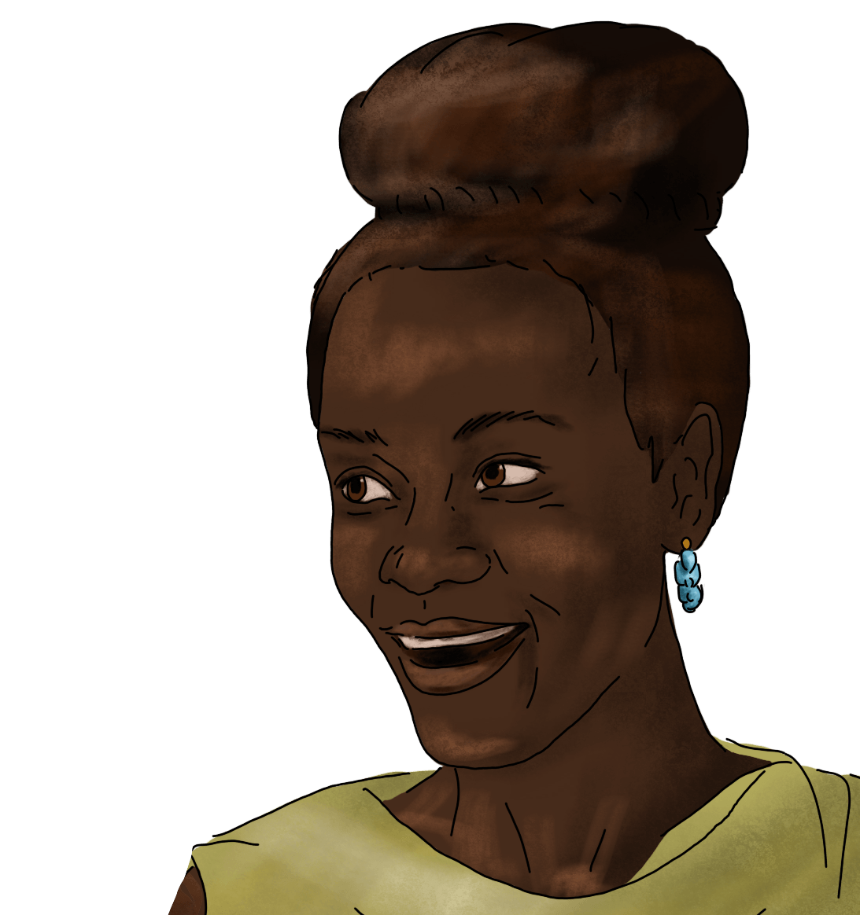

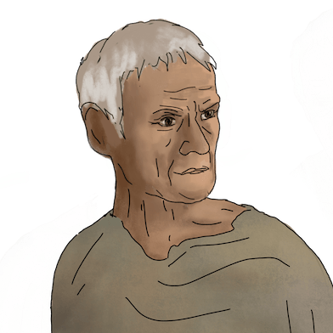
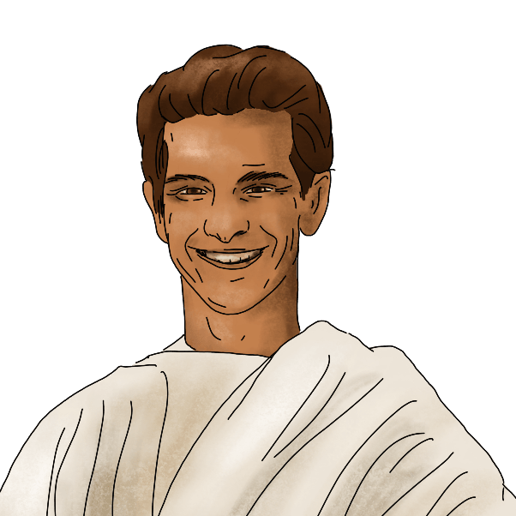
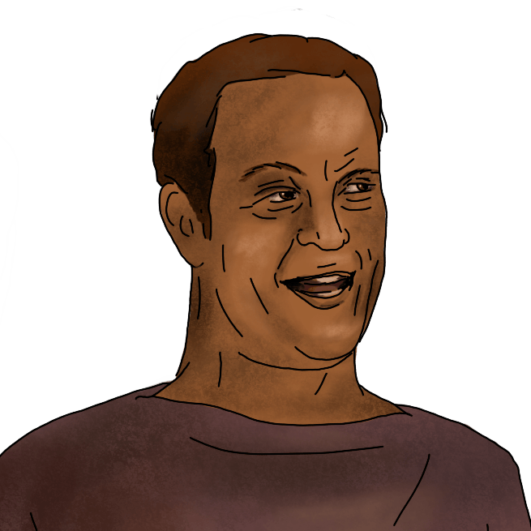
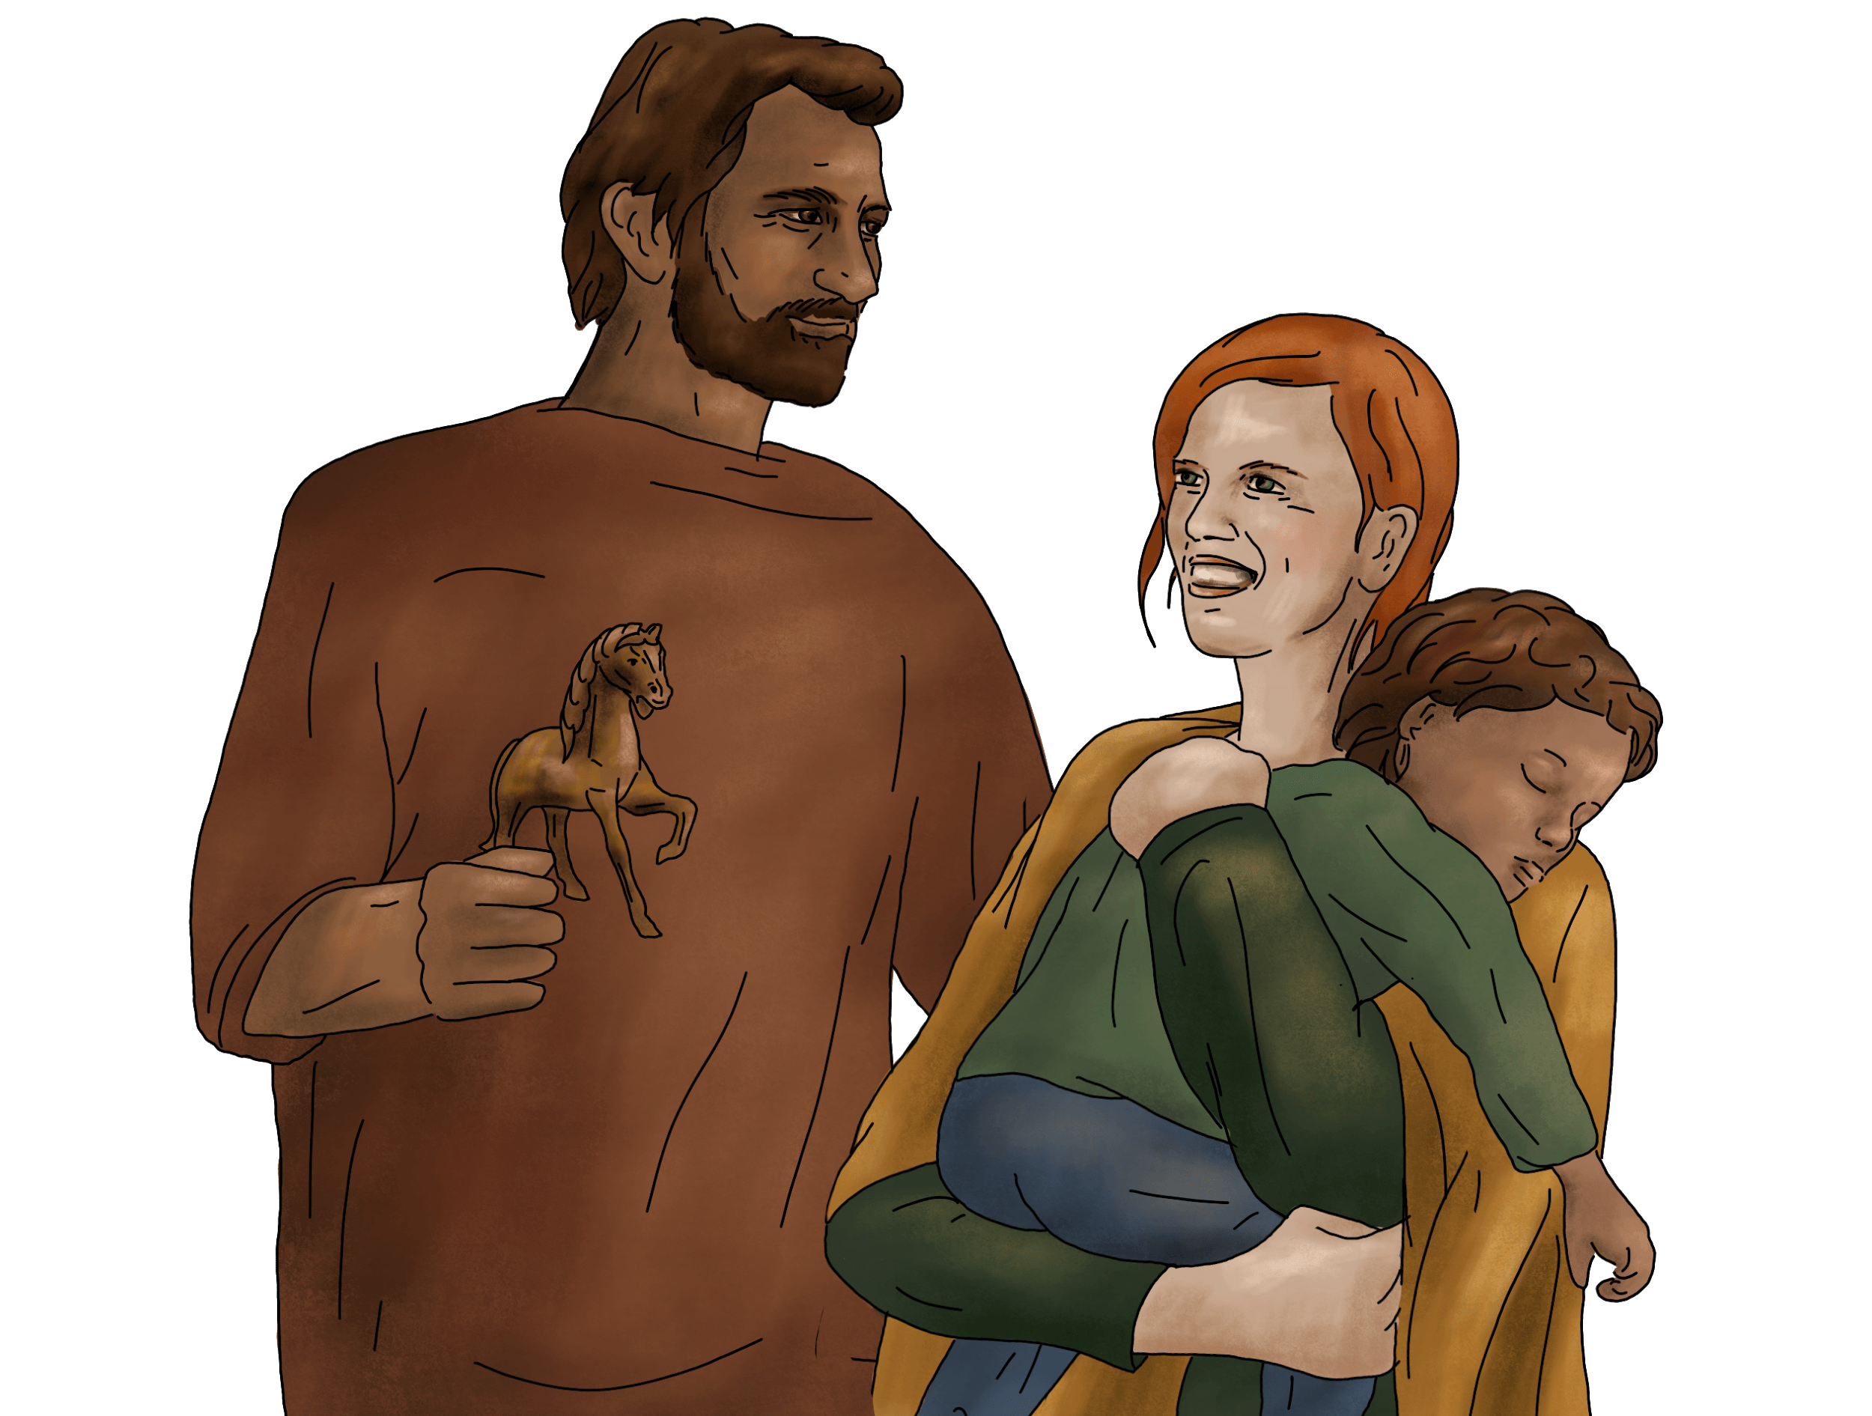
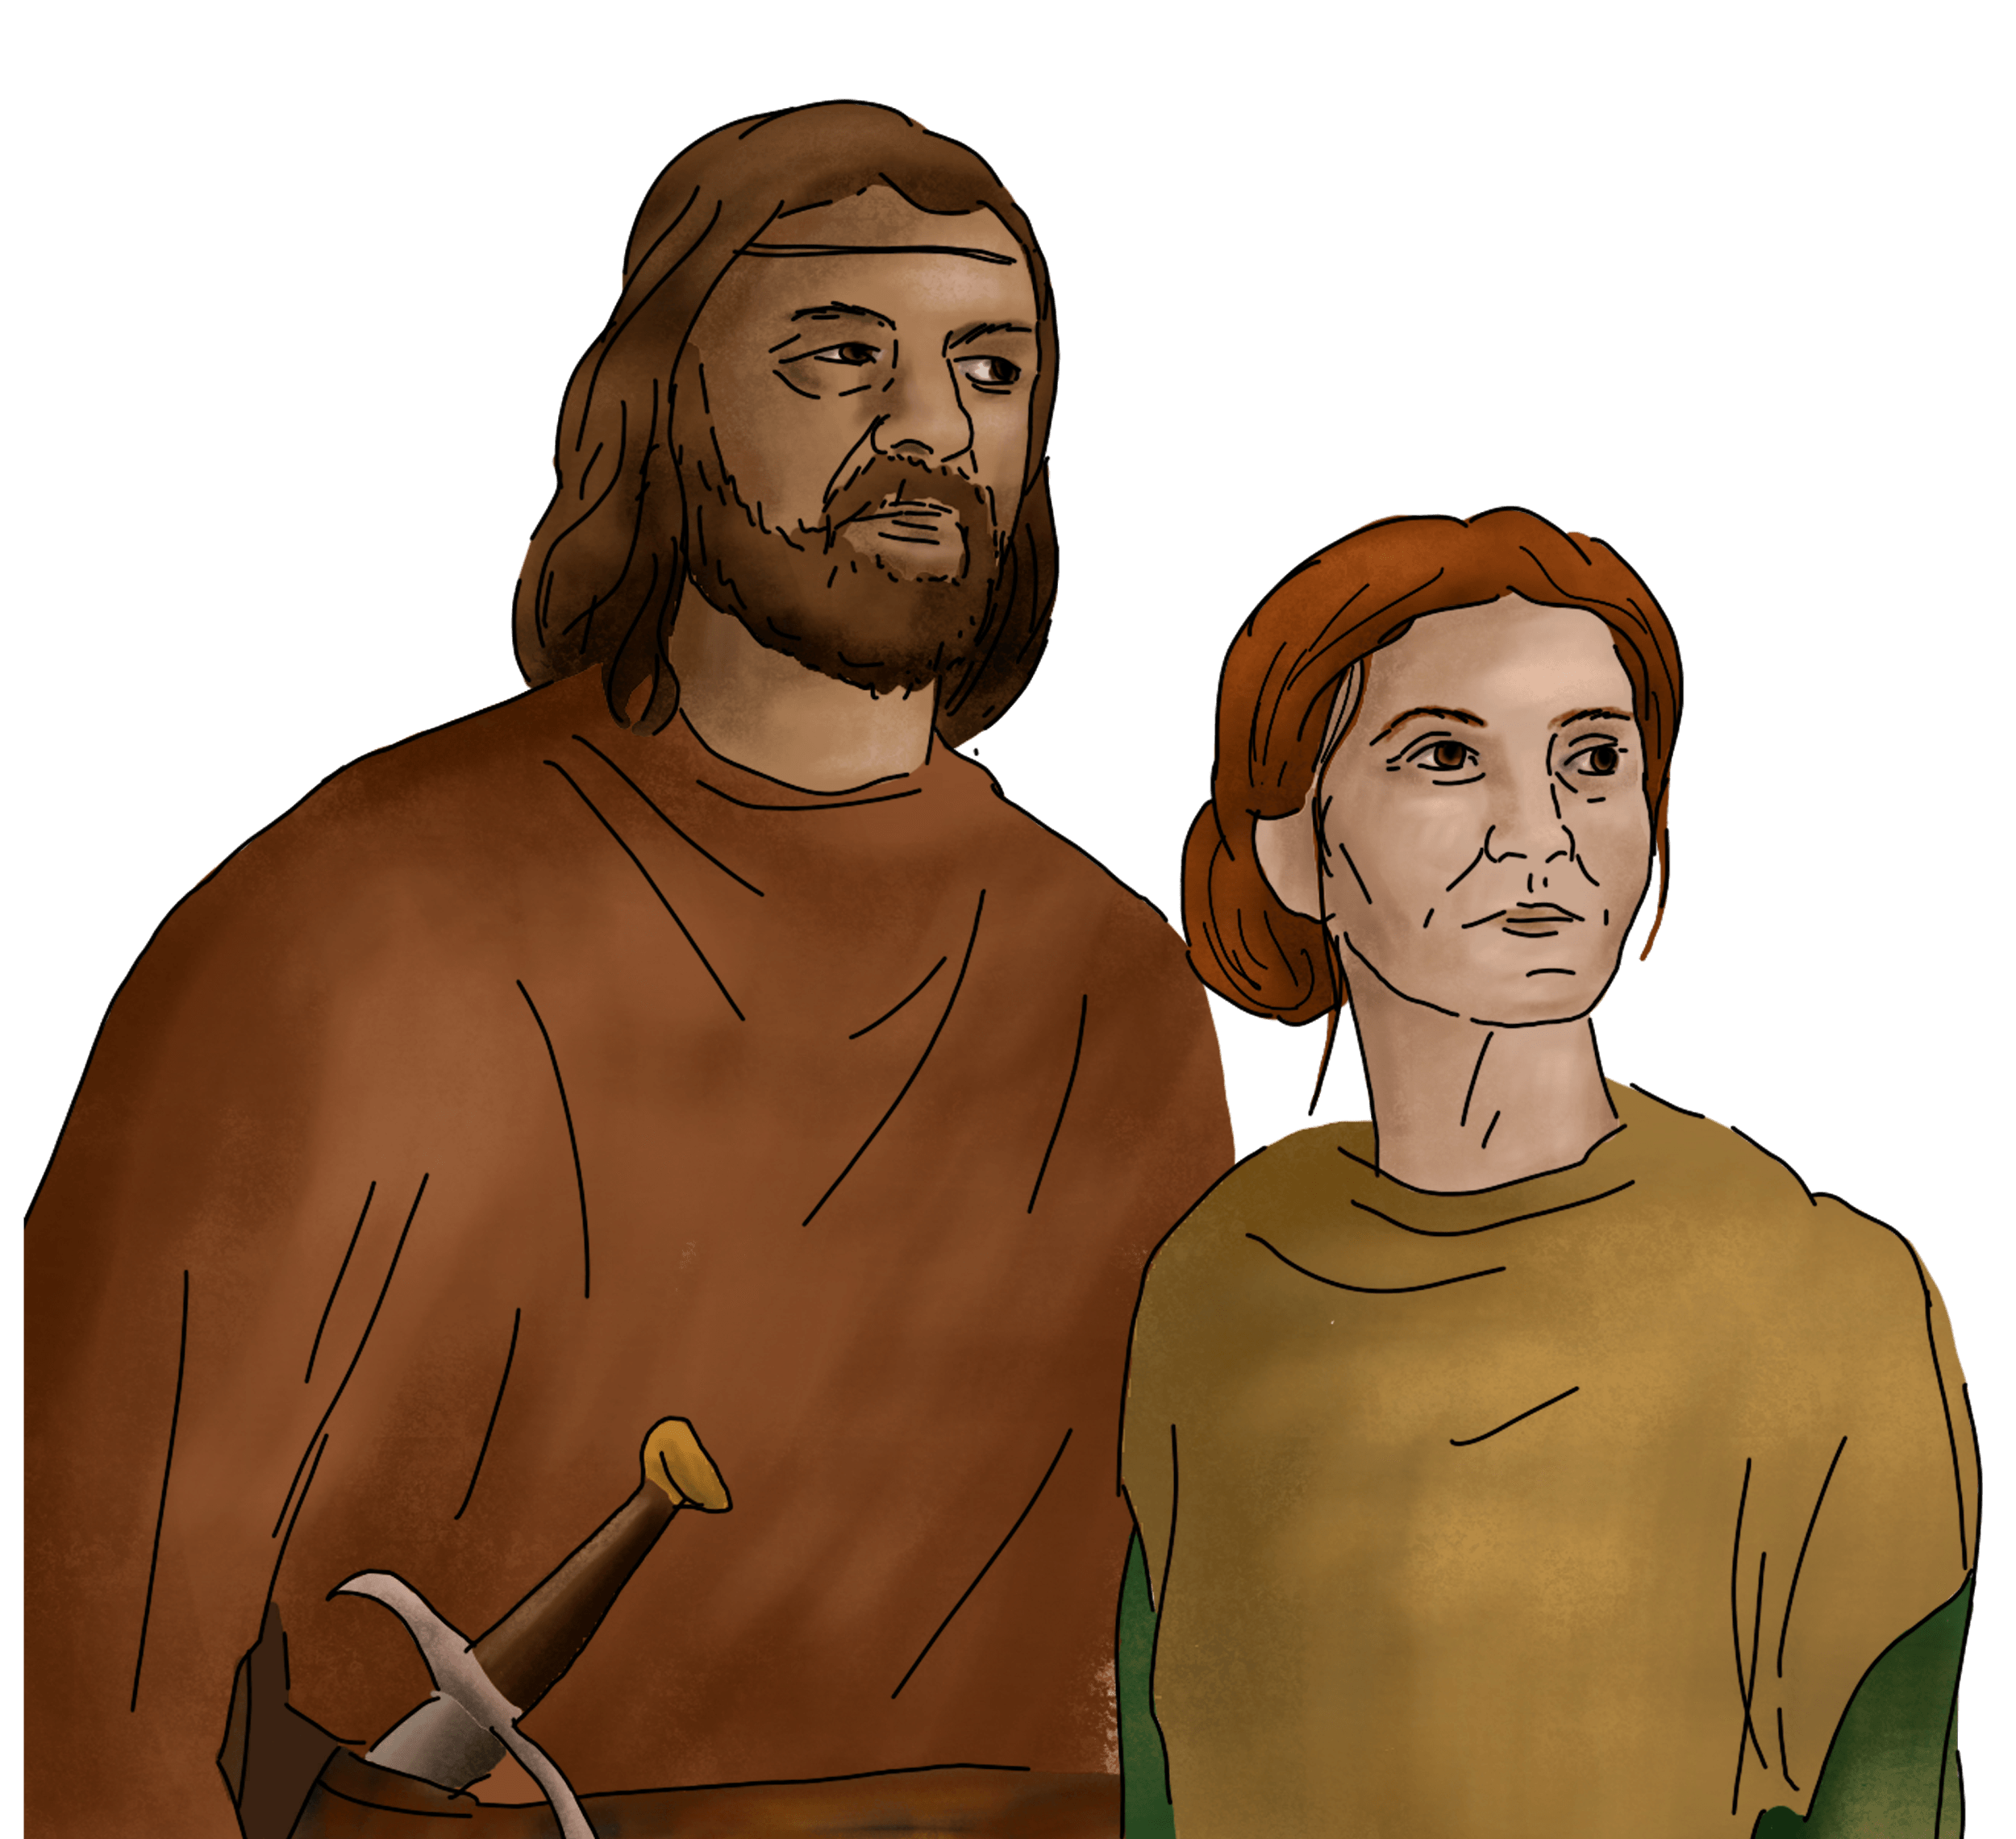
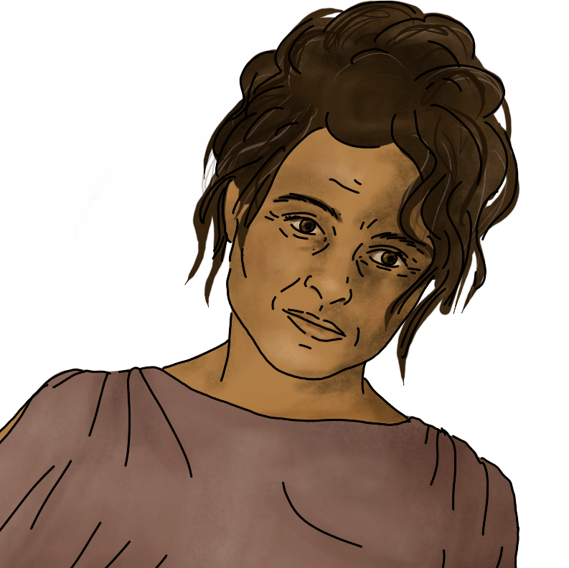
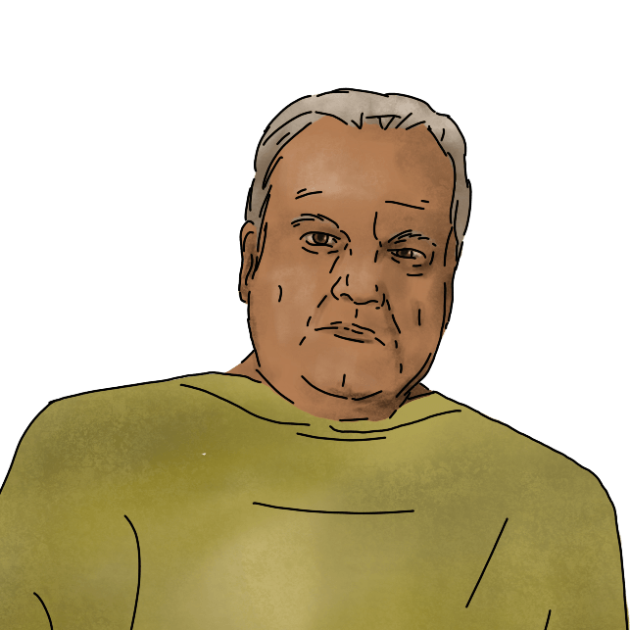
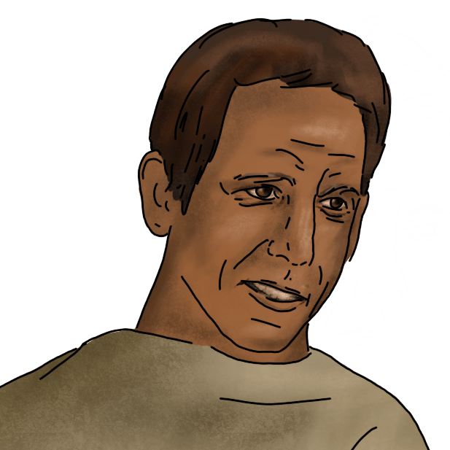
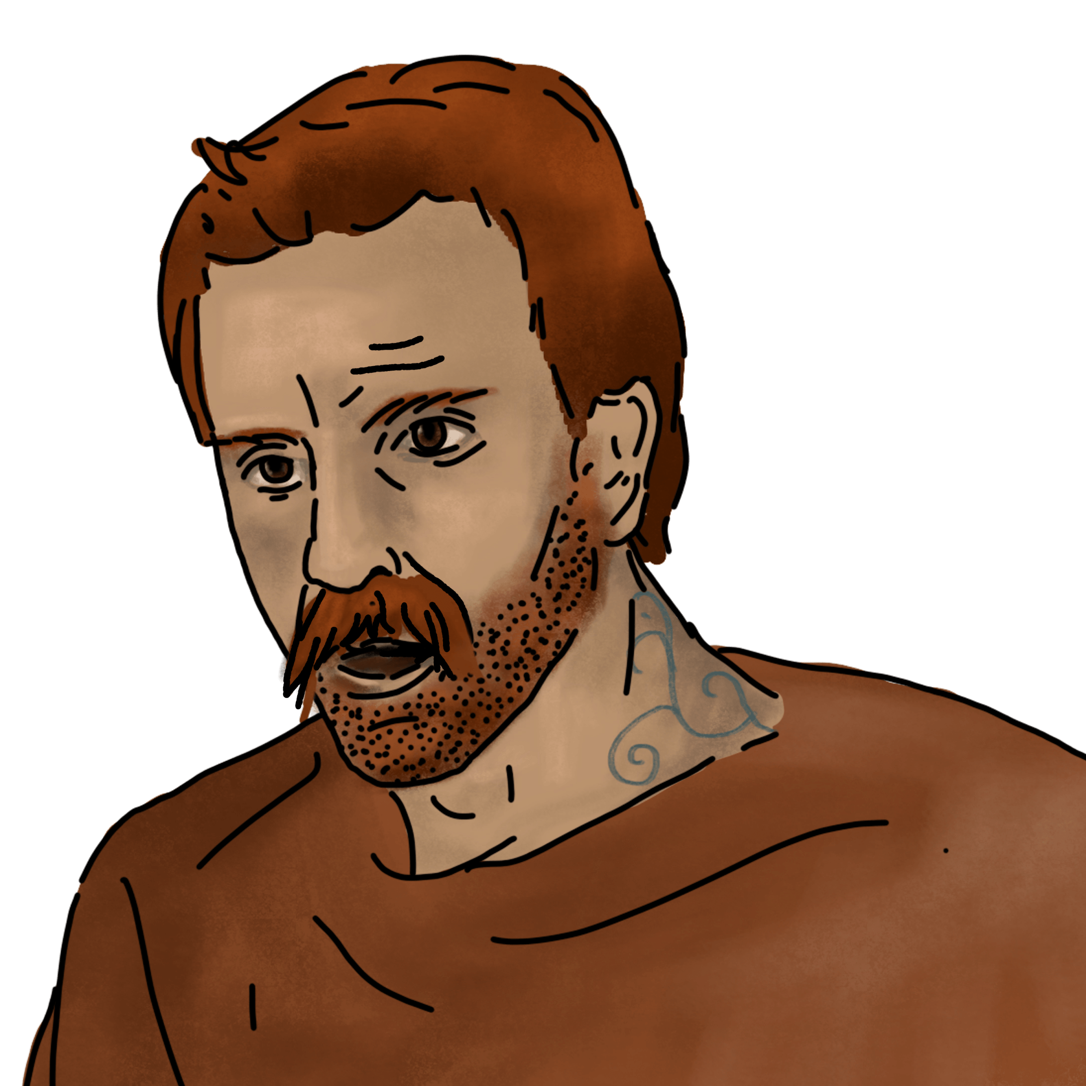

Slide 4
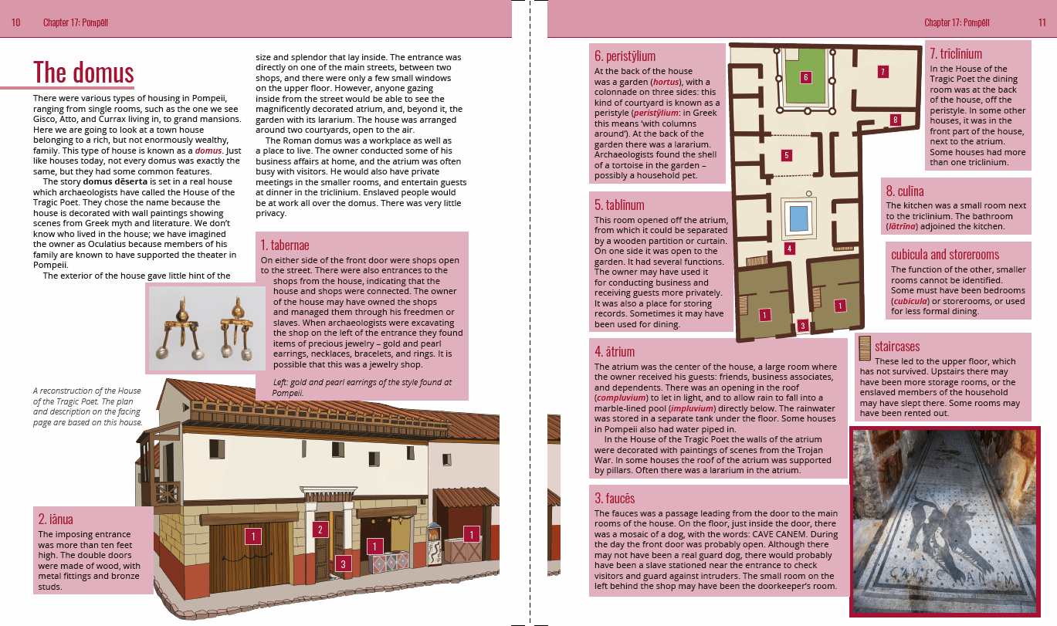

Slide 5
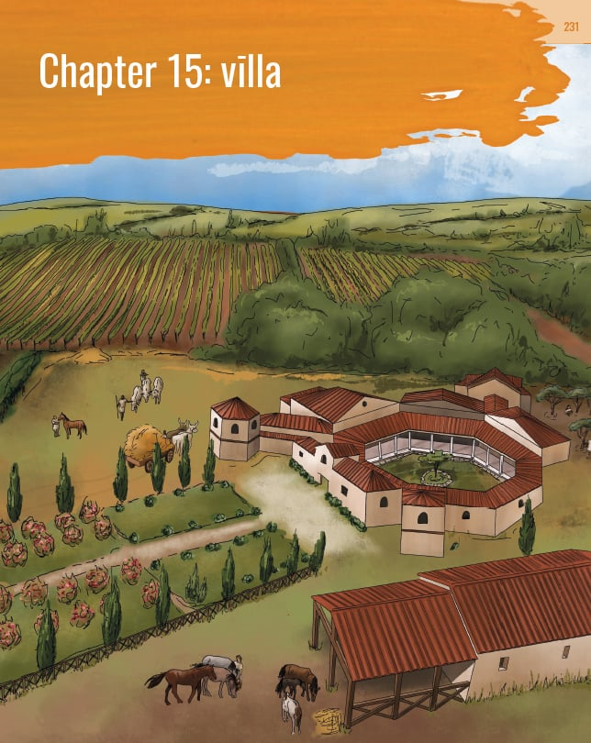

Slide 6
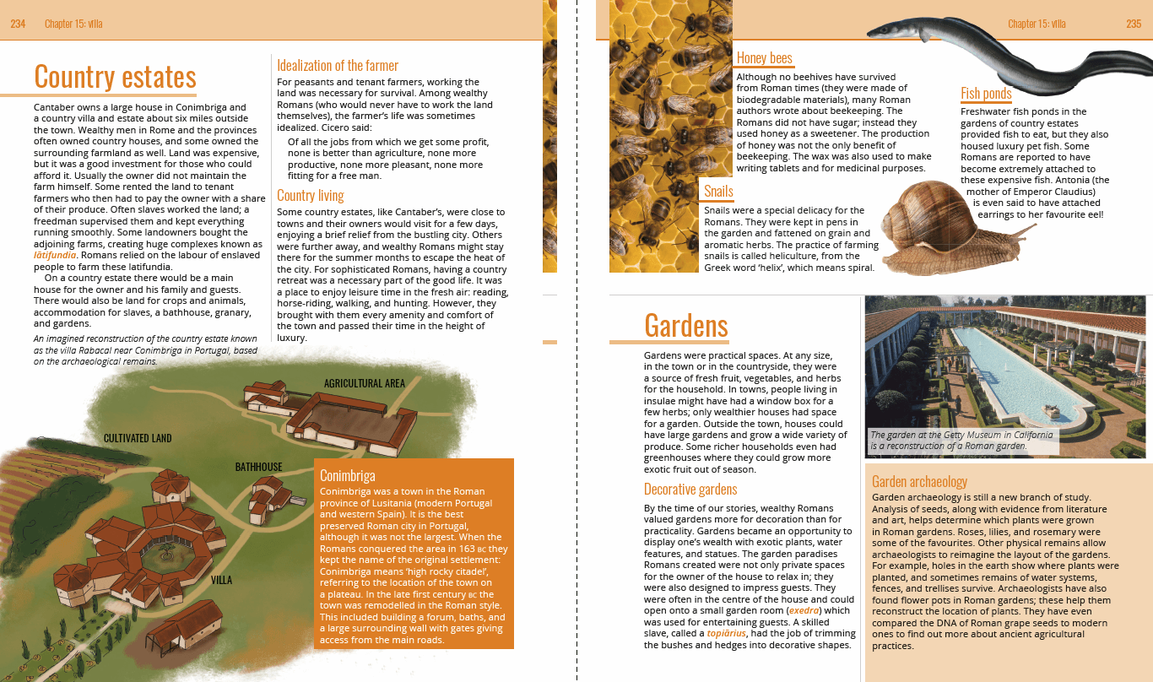

Slide 7
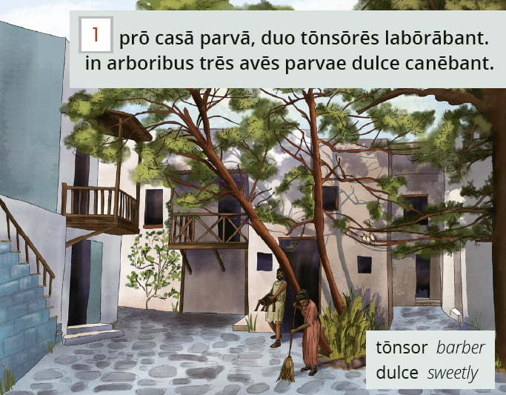
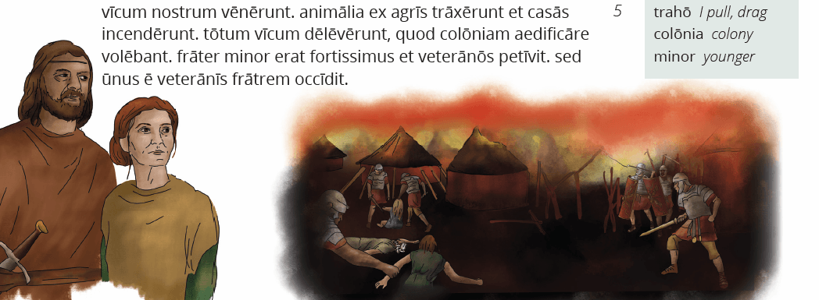

Slide 8
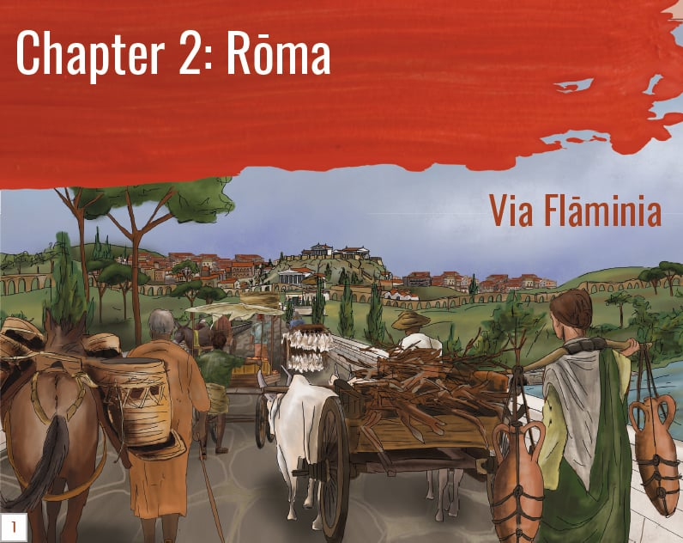
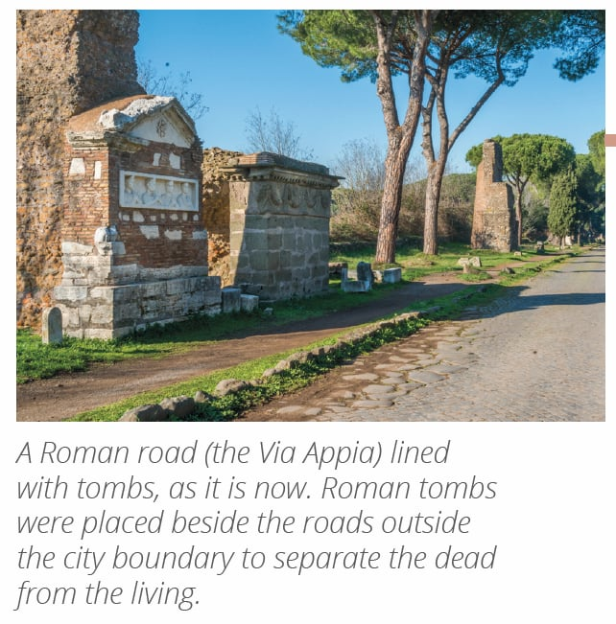

Slide 9

Linguistic map

Slide 10
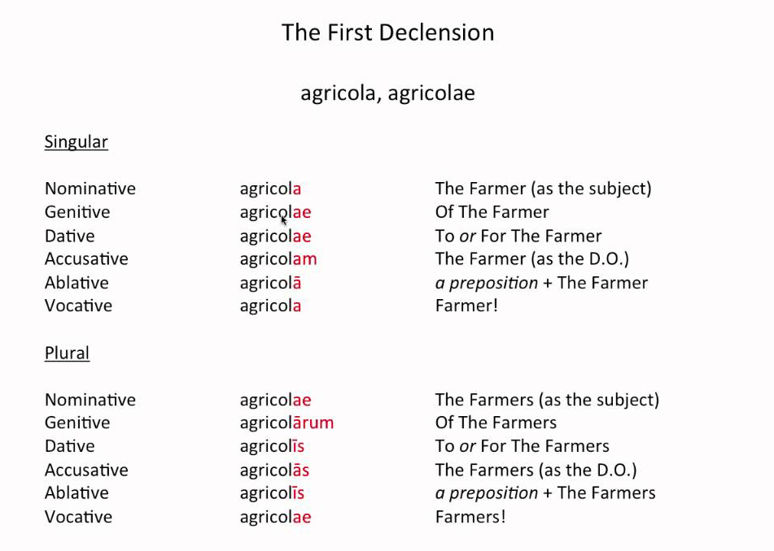

Slide 11
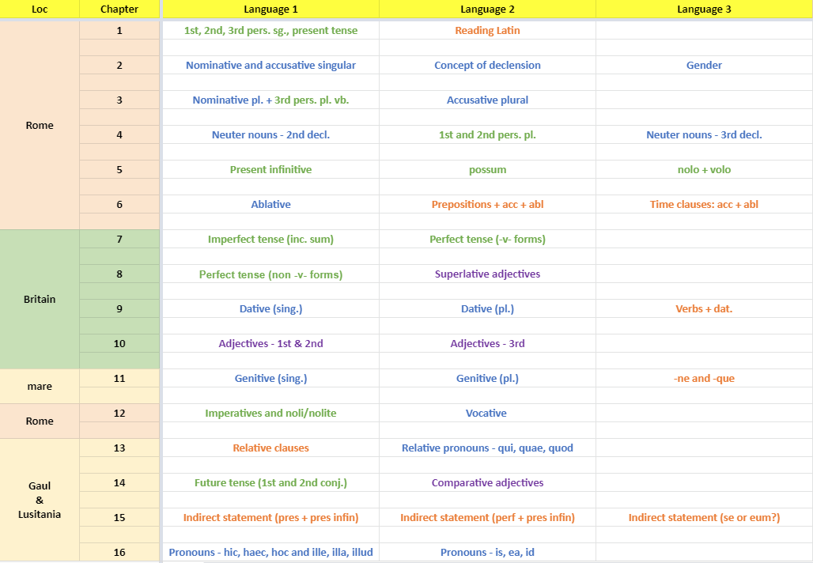

Slide 12
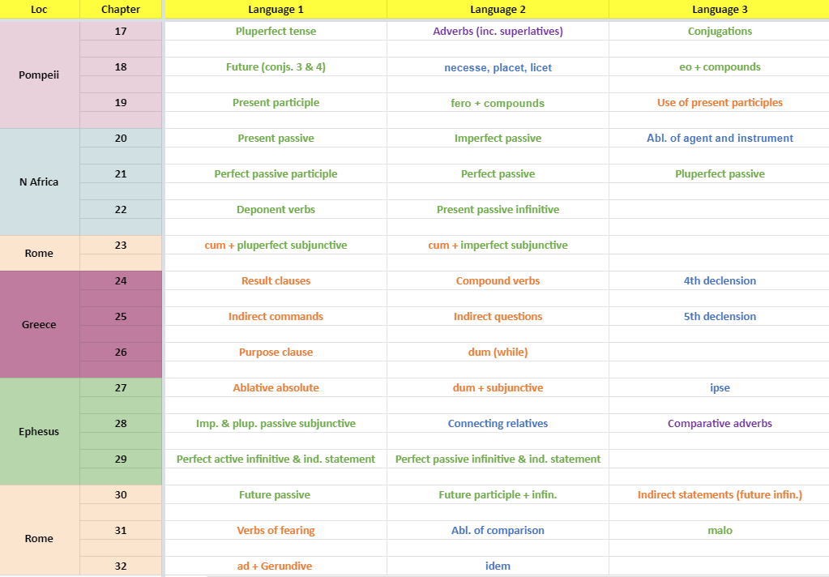

Slide 13
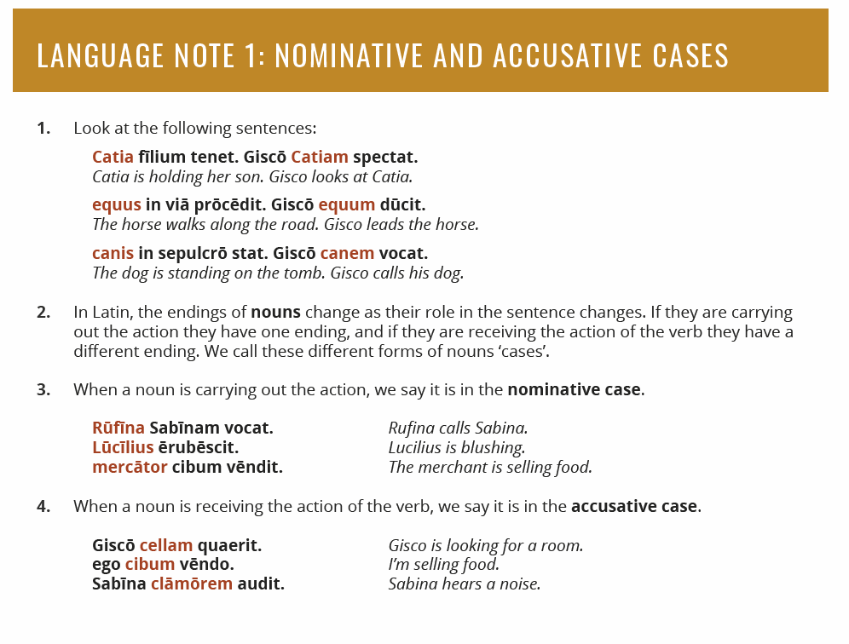

Slide 14
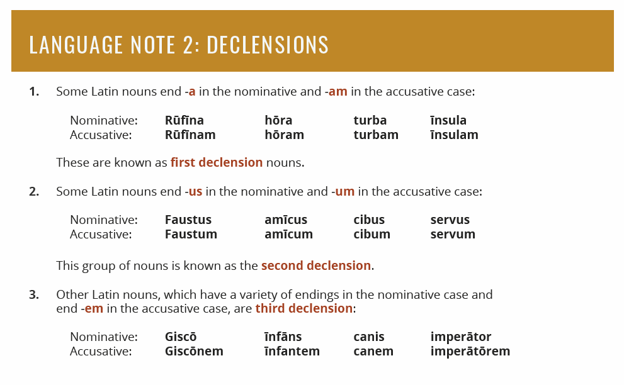

Slide 15
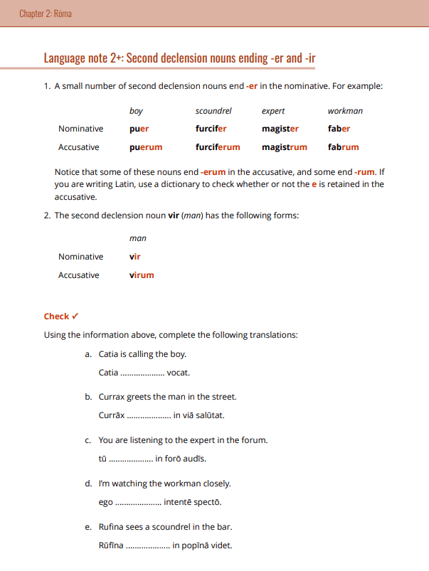

Slide 16
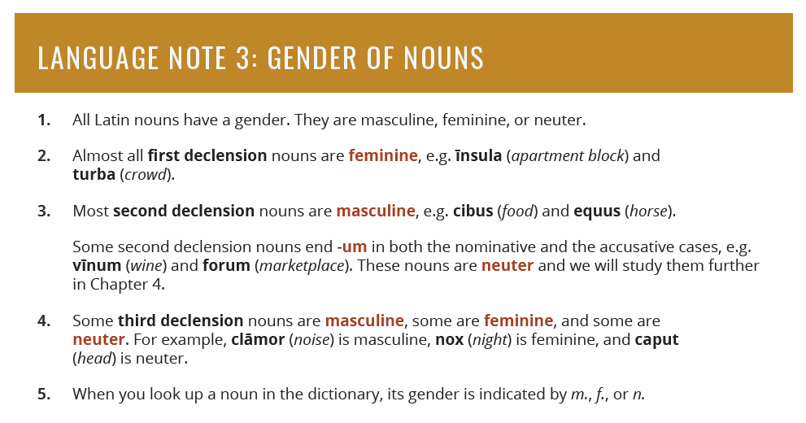

Slide 17
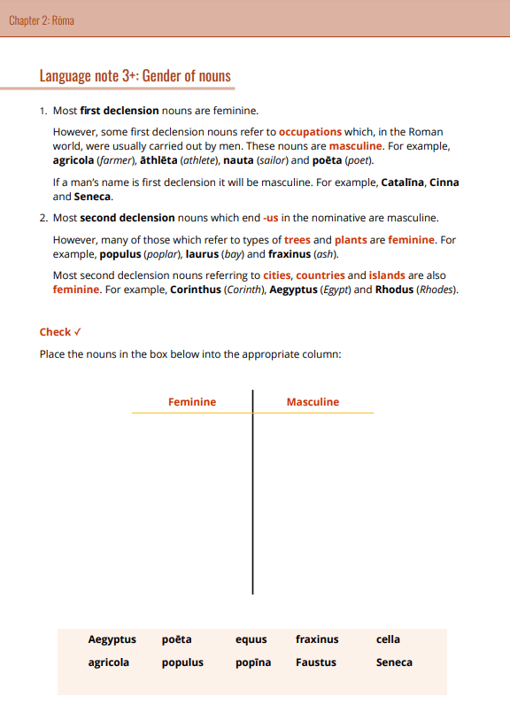

Slide 18
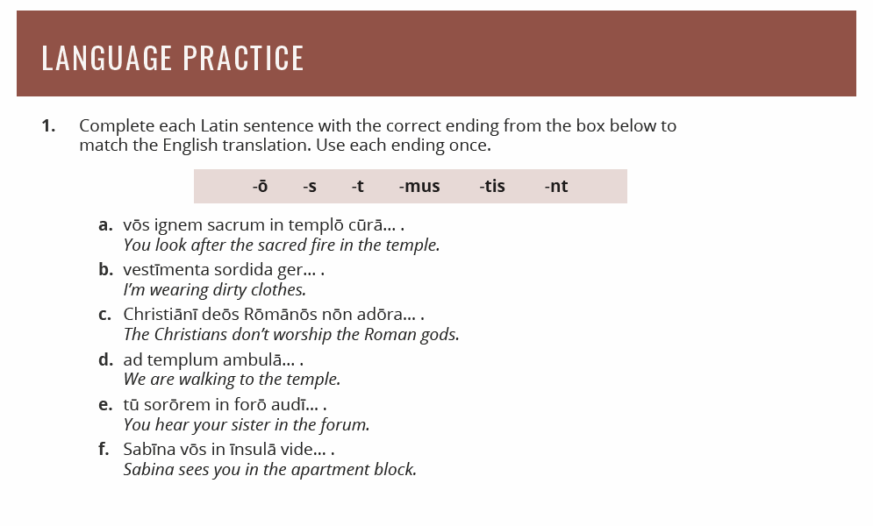

Slide 19
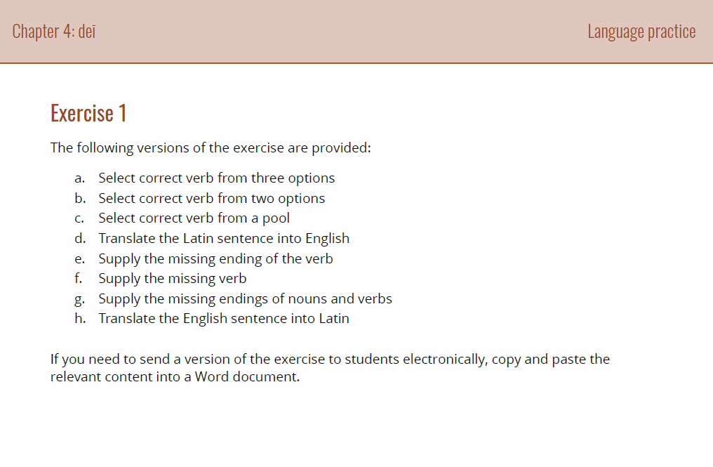

Slide 20
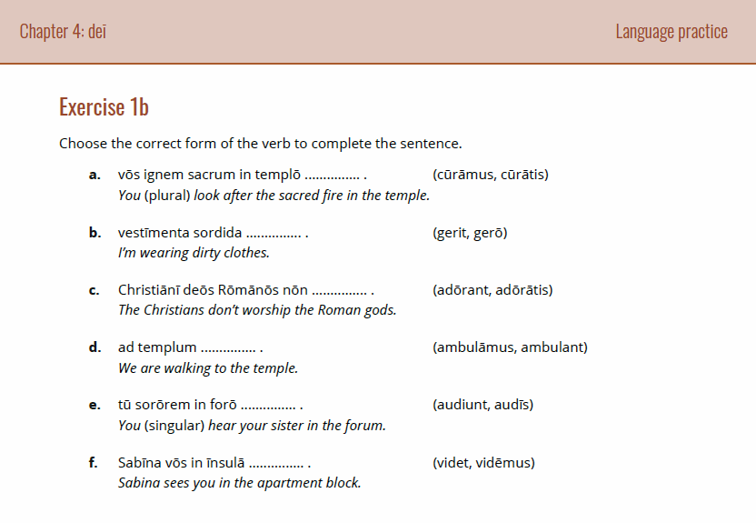

Slide 21
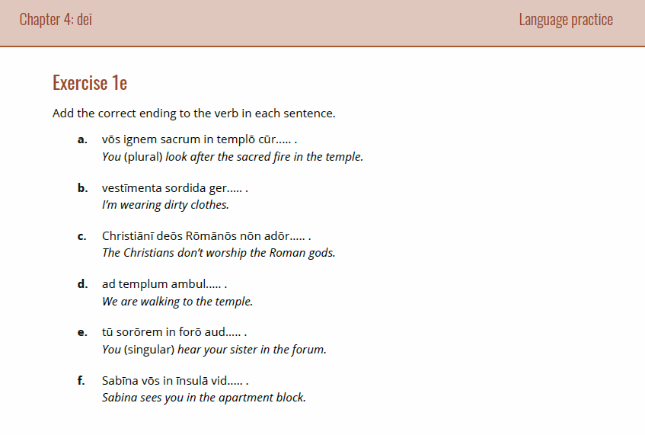

Slide 22
Teaching a chapter

Slide 23
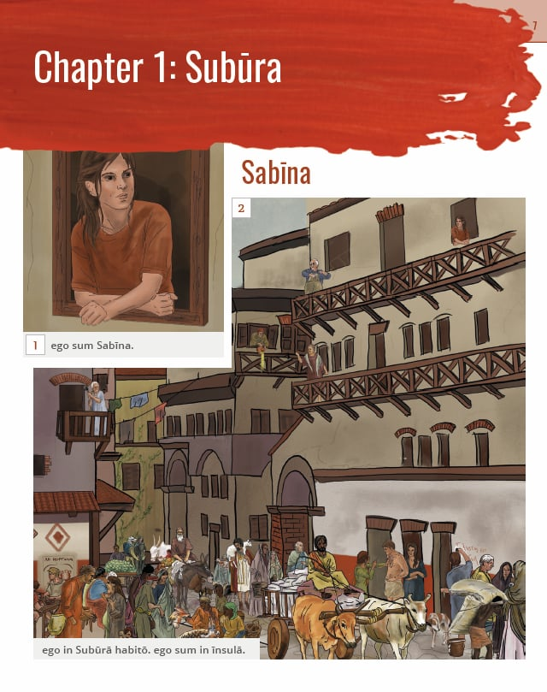

Slide 24
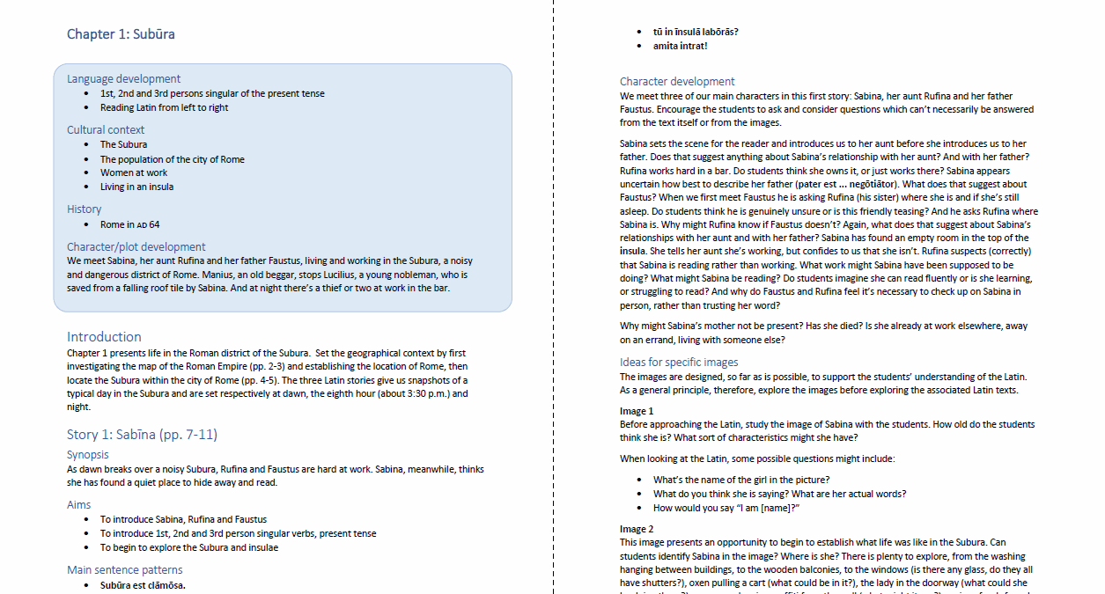

Slide 25
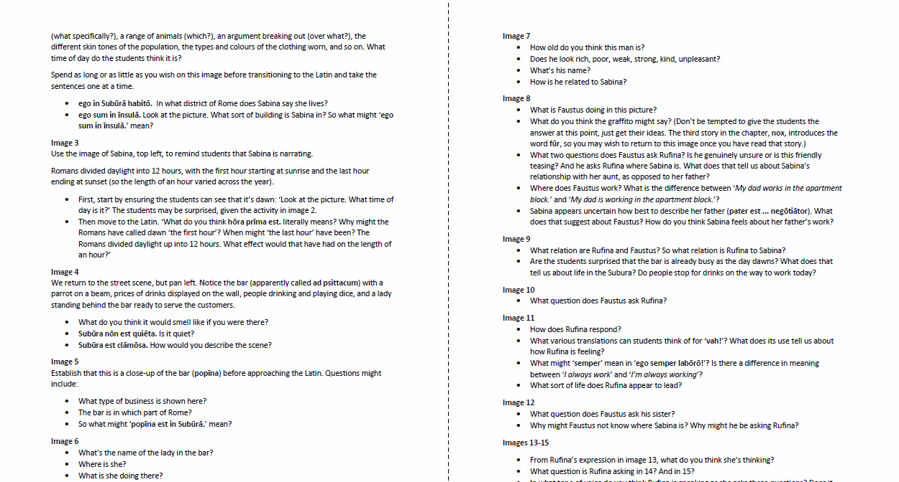

Slide 26
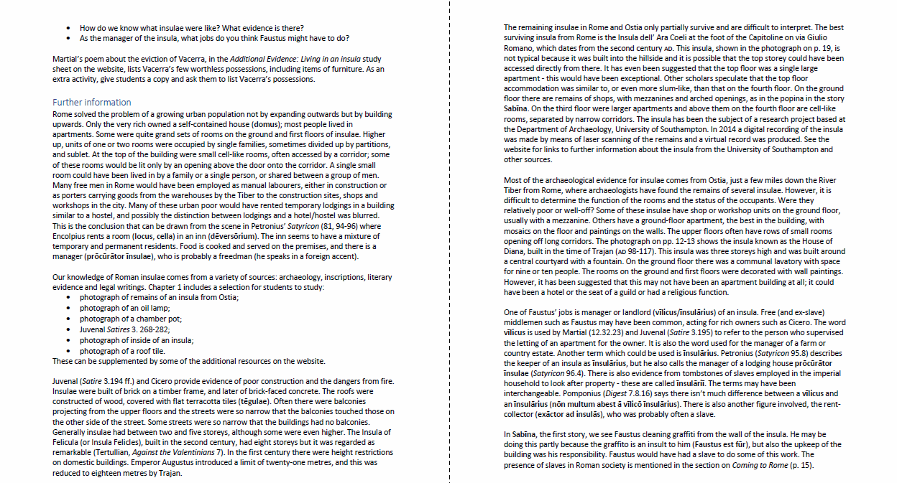

Slide 27
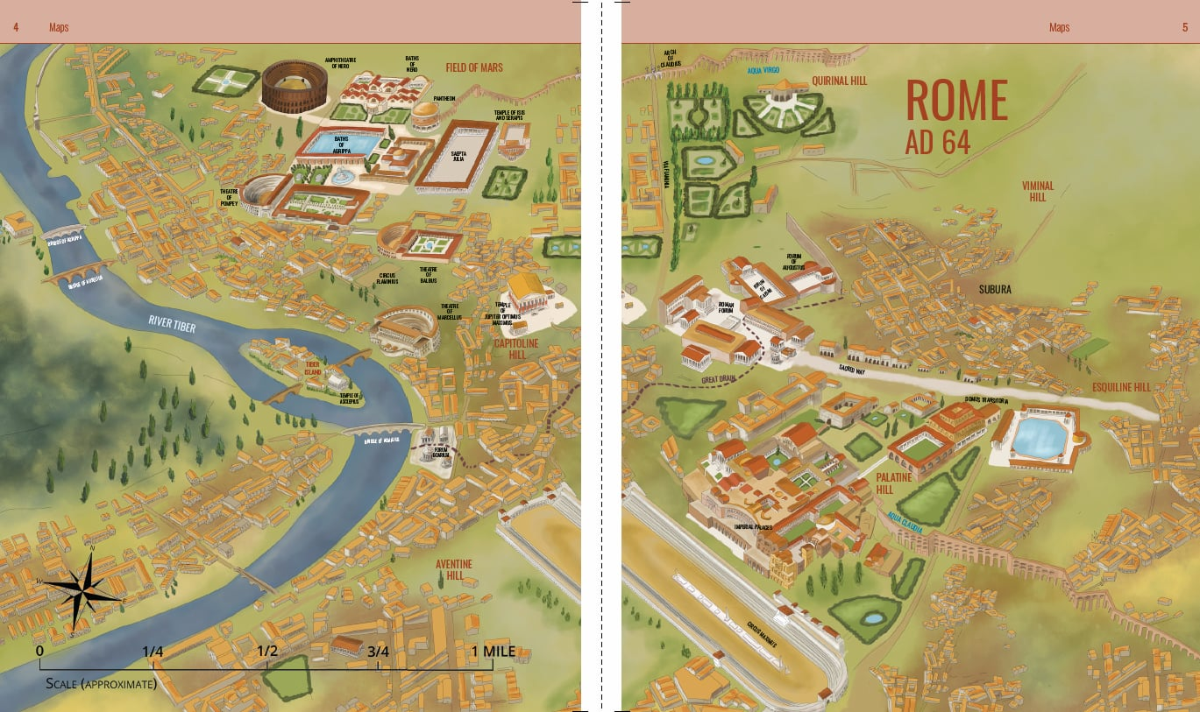

Slide 28
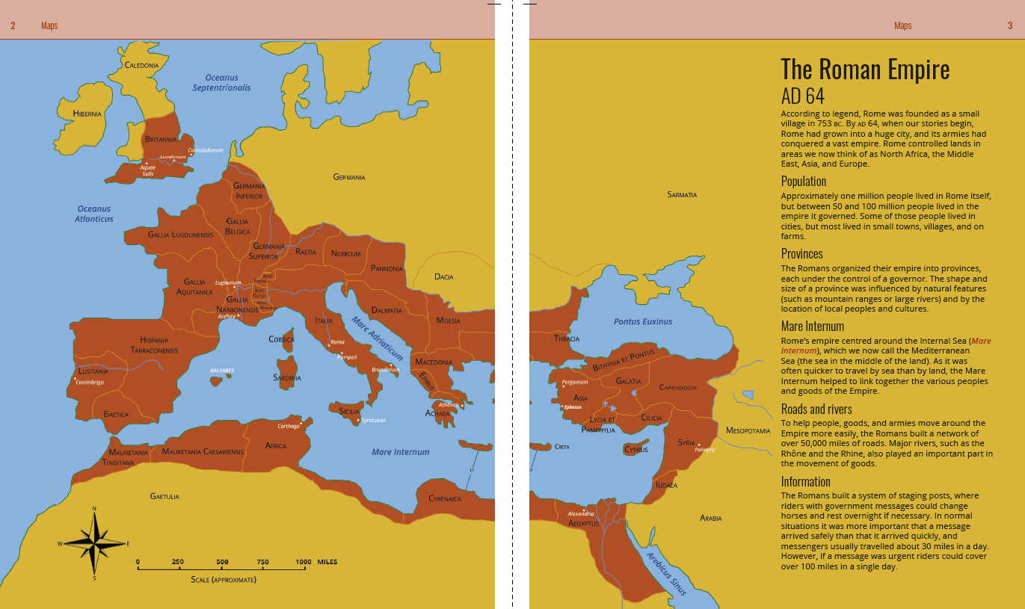

Slide 29
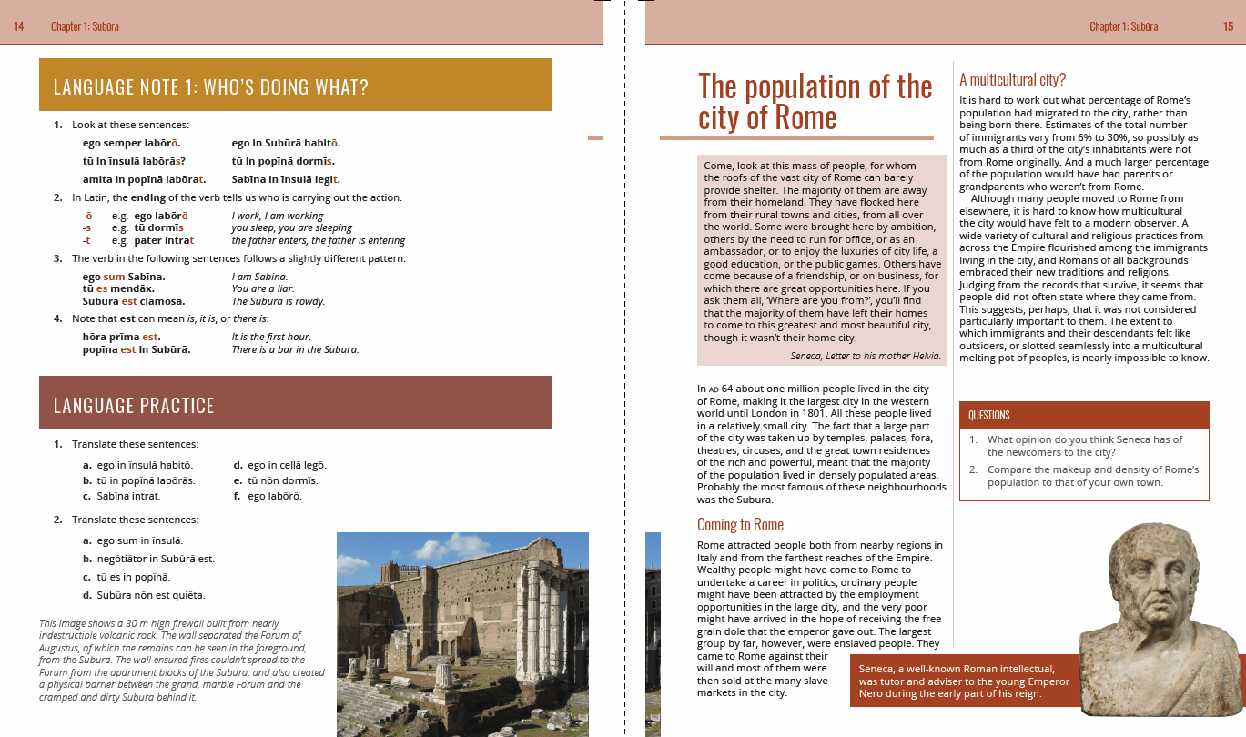

Slide 30
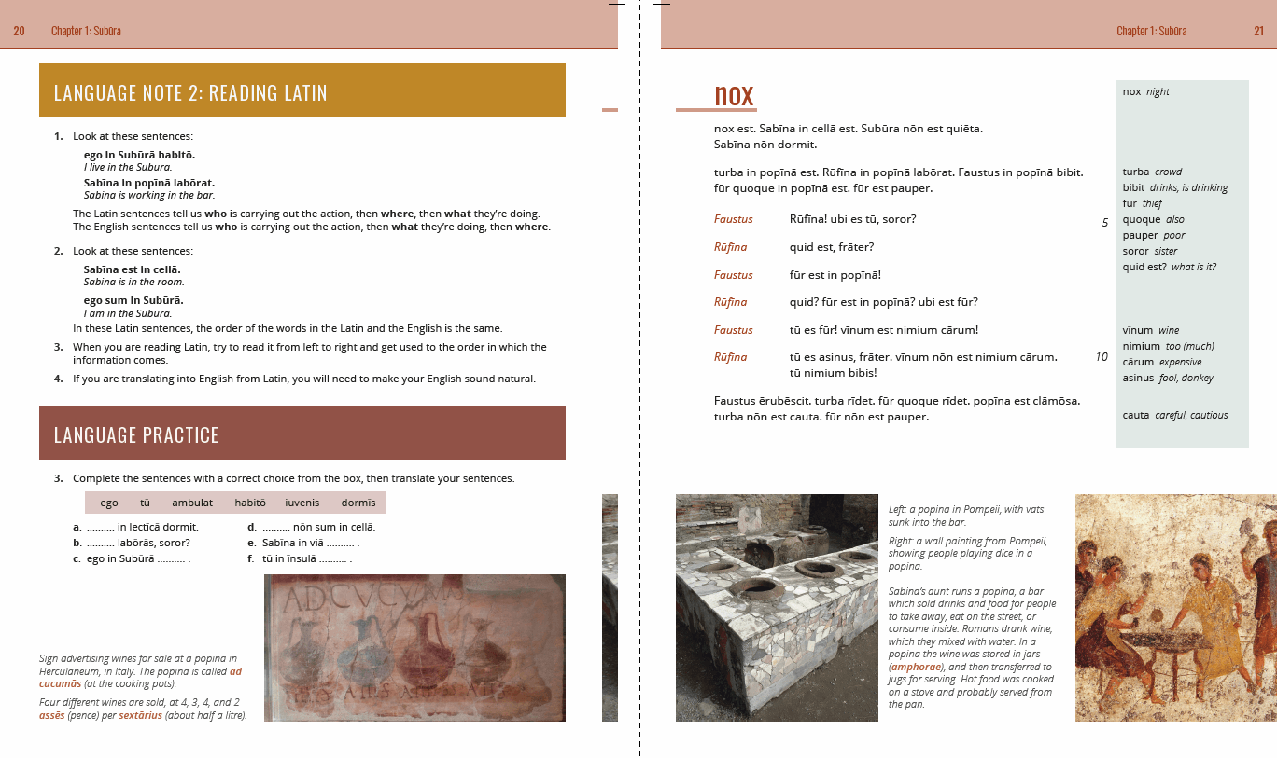

Slide 32
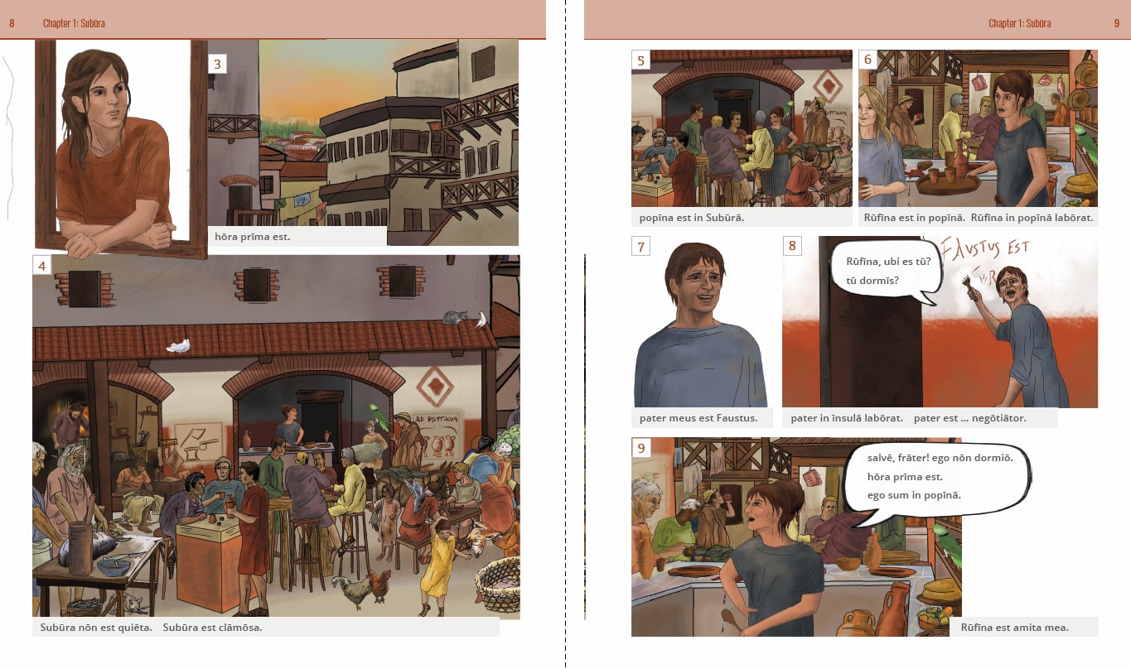

Slide 33
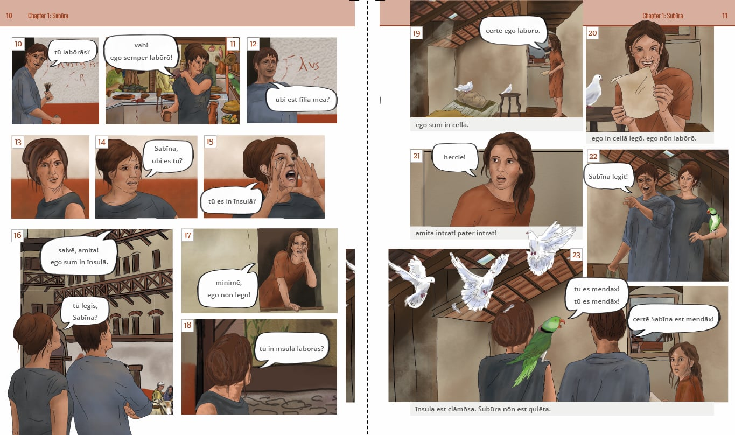

Slide 34


Slide 36


Slide 37


Slide 39


Slide 40


Slide 41



Slide 43


Slide 44


Slide 45


Slide 46


Slide 47


Slide 50


Slide 51


Slide 53


Slide 54


Slide 55


Slide 56


Slide 57


Slide 58


Slide 59


Slide 60

A few tips
The introduction of a new linguistic feature is the area of highest risk – keep it simple and control the focus
Use leading questions, with the appropriate tense, to increase chance of correct response at outset
‘How do you know?’
Separate reading ability from knowledge of terminology
Some, many, all
You cannot teach all Latin grammar in one lesson
Students will remember what they do more than what you say.

Slide 61
Various ways to approach a story
Pre-reading for vocabulary
Pre-reading for sense
Accelerated reading
Cut it up and re-assemble
Act it out
Film directions
Asking the story (oral comprehension questions - in English - in Latin?)
Written comprehension questions
Story in images
Read in pairs
Read as a class (explorer)
Individual reading
Cloze exercises
Simplified versions (differentiated, students choose level)
Listen only (or before/after another activity)
What does this story tell us about Roman culture?
How are the characters presented?
Empathy - take the viewpoint of one of the characters (inc. hot seating)
How is language used?
What happens next?
Find x examples of (e.g. the dative case)
Story-boards
Synchronous sections
Extra script
Image v. text
Tell your neighbour
Dictation
Re-read earlier stories

Slide 62
Vocabulary

Slide 63
Prioritising core vocabulary
Dickinson
  Top 500
  Top 1,000
  Not in top 1,000
GCSE DVLs (Defined Vocabulary Lists)
  B = Both
  E = Either (i.e. on one, but not both)
  N = Neither
puto = B1
repente = N3 (subito = B2)

Slide 64


Slide 65


Slide 66


Slide 67


Slide 68
Tracking vocabulary use
Spreadsheet analysis
Software analysis

Slide 69


Slide 70


Slide 71


Slide 72


Slide 73


Slide 74


Slide 75


Slide 76
Information in vocabulary lists
Gender: Chapter 2
Accusative: Chapter 2
Genitive: Chapter 11
All forms of adjectives: Chapter 10
Infinitive: Chapter 5
1st person perfect: Chapter 7
PPP: Chapter 21

Slide 77

Technology

Slide 78


Slide 79


Slide 80


Slide 81


Slide 82


Slide 83


Slide 84



Slide 85



Slide 86



Slide 87



Slide 88


Slide 89



Slide 90


Slide 91

Suburani: progress tracking (28pt Arial)
1 This is the body text: 8 lines of text max (18pt Arial)
2 This is the body text: 8 lines of text max (18pt Arial) - dark grey 3
3
4
5
6
7

Slide 92


Slide 93


Slide 94


Slide 95


Slide 96
The Research

Slide 97


Slide 98


Slide 99


Slide 100


Slide 101


Slide 102


Slide 103


Slide 104


Slide 105


Slide 106


Slide 107


Slide 108


Slide 109


Slide 110



Slide 111


Slide 112


Slide 113


Slide 114


Slide 115


